Slide 1
Performance Risk
Aristotelis Botzios-Valaskakis
Senior Expert, Centre for Renewable Energy Sources and Energy Saving
meetMED II
Activity 3.1.2 Training Seminar
“Fundamentals of Energy Services and Energy Performance Contracting”

Slide 2
To cover the performance risk of an energy efficiency project with guaranteed savings, energy service providers have to be able to provide the Client with the necessary guarantees. This can be achieved with one of the following methods:
Bank guarantees – However, banks are usually reluctant to assess the performance risks due to high due diligence costs. This can be partially overcome with standardized energy services. Furthermore, the banks are also not willing to offer guarantees based on the future cash flows of the project (cost savings rather than generated income) and, in most cases, demand collateral.
Public guarantee funds
Insurance schemes.

Slide 3
Energy savings insurance is a policy to cover clients in the event that promised energy savings are not achieved, and that the energy service provider cannot fulfil its commitments.
The goals of the energy savings insurance are to:
Provide a guarantee that reduces the energy efficiency investment risk for clients by insuring the energy service providers’ savings guarantee commitment
Increase the commercial banks’ willingness to lend to the clients for these project types given the reduced default risk

Slide 4
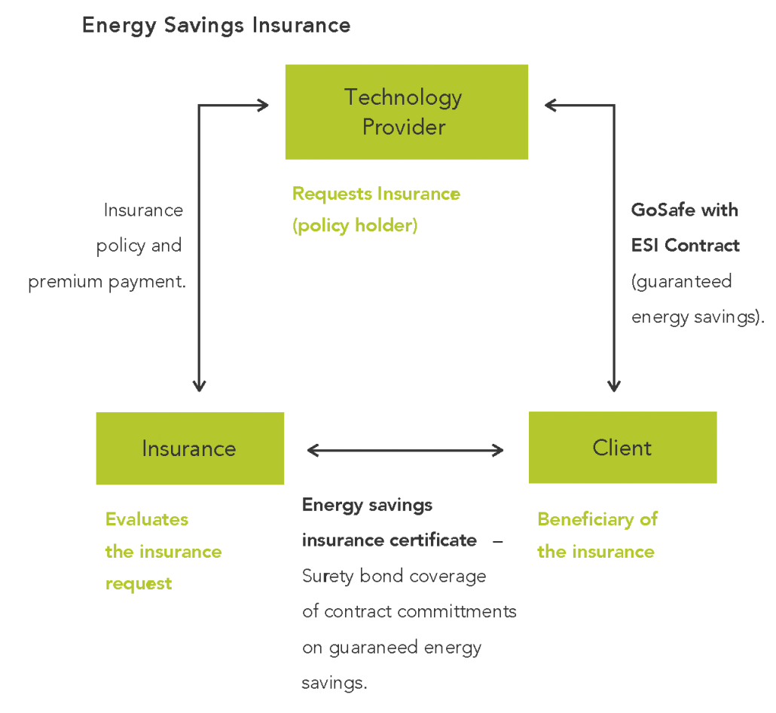
The energy savings insurance is a surety bond type of insurance, which is a contractual agreement among three parties: the energy service provider, the insurance company and the client.

Slide 5
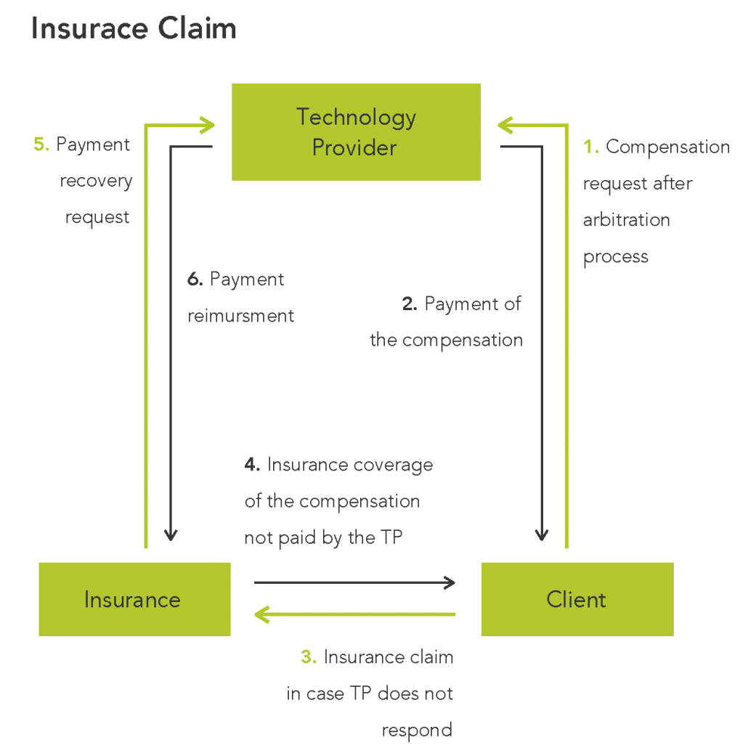
The energy savings insurance is linked to the energy performance contract and is triggered if specific clauses of the contract are not met.
In the case of reported energy savings that are not agreed by the Client and energy service provider, an arbitration process is initiated.
The Validation Entity carries out the arbitration procedure, which includes evaluating the reported energy savings and assessing potential energy savings defaults to be compensated to the Client.

Slide 6
Contact us!
For any inquires or comments, please don’t hesitate to contact us
www.meetmed.org meetMED Project
@meetmed1

