Slide 1
Re-Financing
Aristotelis Botzios-Valaskakis
Senior Expert, Centre for Renewable Energy Sources and Energy Saving
meetMED II
Activity 3.1.2 Training Seminar
“Fundamentals of Energy Services and Energy Performance Contracting”

Slide 2
There exist many financial institutions (FI) that have formulated strategic focus areas around green and sustainable financing and thus would also like to finance more EE-projects , but – in contrast to investments in the renewable energy sector – they have difficulties to find the right channels through which the supply with additional capital would really stimulate market growth. It seems that the peculiarities of EEI investments do not fit well to the requirements of financial institutions.

Slide 3
Generally, the financing instruments available for EEI investments are limited:
The use of leasing financing – operational leasing as wells as financial leasing – may play a certain role but due to limitation to leasable goods (i.e. objects which can be used as independent economic goods and which are fungible) this instrument can only cover a limited share of the typical investment needs of EEI projects.
Since EEI investments are typically rather small, project financing – which is based primarily on the cash flows of the project rather than on the balance sheet of the investor – is an option only for exceptional cases, because of high transaction cost for project due diligence.
As a result, the far prevailing share of EE-projects has to be financed by ordinary loans that are secured against the balance sheet of the investor. The creditworthiness of the investor – and thus the balance sheet ratios – are the decisive factors, largely independent from the quality of the project itself.

Slide 4
Against this background, we have to conclude that major growth in EE finance can happen only through loan financing as this will remain the usual financing approach for EE projects.
This means that either the client or the EES provider (ESCO) have the investments on their balance sheets. Since EE projects compete with other investment options, clients frequently will have reservations in limiting the financial leeway, whereas EES providers will soon be confronted with a situation, where they will reach their own credit limits and will have to reject EE projects.
Therefore, if remarkable market growth is intended, the major question is how the balance sheets could be cleaned up in order to gain financial leeway to expand business.

Slide 5
The establishment of a solid refinancing cycle through the sale of receivables is a promising way to support supply of financing for market growth.
In a refinancing scheme, the EE project is financed initially through a corporate loan (e.g. overdraft) provided by a bank to an EES provider, this means that the EEI investment is implemented in the frame of an EES project. The client profits from this approach as he is not forced to burden his balance sheet while he takes advantage of the broad scale of benefits of the EEI investment.
A certain period after the investment has been implemented and performance of the investment has been demonstrated, the EES provider sells off the expected receivables to a refinancing institution and gets cash upfront for the receivables, while the buyer gets the right to collect the receivables. By this way, the EES provider clears his balance sheets and gains leeway for financing of new projects which he could not realize otherwise.
Therefore, the possibility of refinancing through the sale of receivables is a major element supporting the growth of the EES provider.

Slide 6
The application of refinancing schemes has several additional benefits, that are important for market growth:
Refinancing schemes can be used as a vehicle to bundle a number of smaller projects to a larger package in order to reach the thresholds and enable the involvement of larger investment funds.
Generally, EE projects have a strong potential to attract investment funds (thematic funds), but it is very difficult for them to get engaged in initial financing (projects too small, high transaction cost, etc.). If well prepared and streamlined, the refinancing cycle is a good entrance door to bring investment funds as new players into the game for EE financing.
Finally, the establishment of solid refinancing cycles is a tool the supports the activities of SMEs as EES providers. While larger ESCOs dispose of a portfolio of financing options, the financing structure of SMEs depends for the most part on corporate loans secured against the balance sheet. Through sale of receivables they have the possibility to expand their business quicker than in a business-as-usual scenario.

Slide 7
Loan guarantees are provided in many member states for bank loans to finance long-term investments of companies and – in the housing sector – of home owners (state-backed housing loan programmes are usually including an “implicit guarantee” because they are offered to debtors who would not qualify for a commercial loan).
In most cases, public credit guarantees can (only) be called when the debtor gets insolvent. They are usually covering not 100%, but 80% of the loan to motivate the guaranteed bank to manage the loan exposure also in its own interest.
This quite common type of guarantees is protecting creditors from the loss of the asset value of the outstanding loan and is supporting investment in assets which are on the balance sheet of a company or a building owner. It helps asset-based financing of EEI investments, for which the house or company owner would otherwise not be able to raise financing because of creditworthiness issues.

Slide 8
For refinancing EEI investments and securitization-backed forfeiting schemes credit guarantees are not the appropriate guarantee type. Loan guarantees cover the repayment of a loan by the debtor. But the EES provider does not grant a loan to the customer. With forfeiting, the credit risk (more exactly: the risk of payment default by the customer) is transferred to the financial investor, who has purchased future receivables against the customer, but did not grant a loan either.
Guarantees which can be called when payment arrears occur are provided by export guarantee systems in many member states. This type of guarantees is protecting supplier credit against payment default of the customer. However, this type of guarantees is not simply a payment guarantee which can be called unconditionally when payment becomes due and is not paid on time. Export guarantees are protecting the exporter against a loss from an export contract. They are a “loss insurance”, which has a certain predefined maximum coverage, but pays out only the amount corresponding to the actual damage.

Slide 9
Summing up, loan guarantees can be a valuable support for asset owners investing themselves in EES projects and for working capital loans to technology suppliers, but they are not appropriate guarantee instruments for refinancing EEI Investments because they do not cover payment obligations based on a contract on delivering energy or service.
Payment obligations of customers can be the subject of export guarantees, which can also cover payment default risks of purchased receivables when they become due. However, the claim on an export guarantee is covering the cash loss of the exporter. This Loss insurance therefore does not necessarily cover the full payment risk of financial investors.
The “ideal” guarantee for refinancing EEI investments via forfeiting receivables would be an unconditional bank guarantee which is covering exactly any scheduled amount when due.

Slide 10
Unconditional payment guarantees are not provided directly by public guarantee schemes. But if a public loss insurance is available, a payment guarantee by a private bank can be structured using the loss insurance as a credit risk backstop. And when refinancing by selling the receivables to financial investors is secured, a public loan guarantee will be easily available on a working capital loan to the supplier or the ESCO for financing the construction phase.
It must be noted that public loss insurance schemes do not usually cover performance risk.

Slide 11
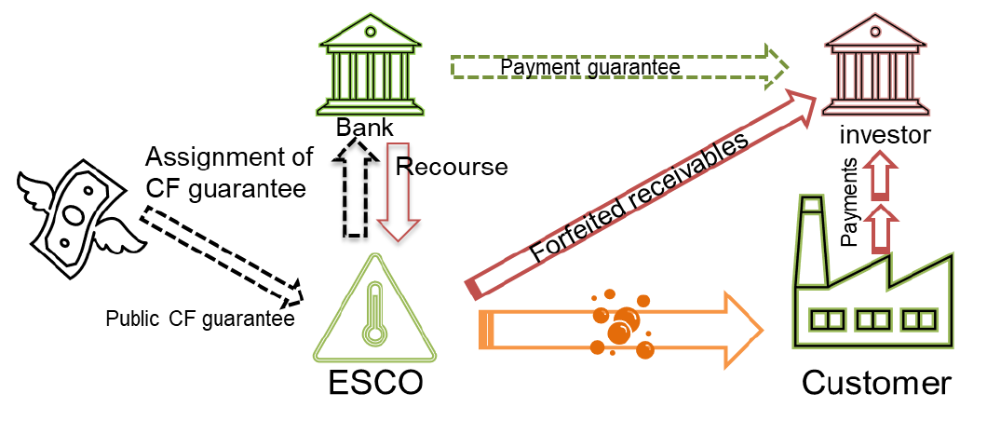

Slide 12
The ESCO applies to the public guarantee agency for a guarantee for a working capital loan by its bank. The loan is used to finance the EE investment to fulfill the investment obligation of the ESCO in the EPC contract with the customer.
After installation, the EE investment is tested for compliance with the performance promise in the EPC contract and commissioned by the customer. The customer starts the payments for the delivered energy or energy savings.
The ESCO applies for cash shortfall guarantee at the public guarantee agency, and asks his bank to provide a payment guarantee to the financial investor who is offering to purchase the receivables against the customer. As a security for the payment guarantee, the ESCO assigns the cash shortfall guarantee to the bank.

Slide 13
The purchase price for the receivables is used by the ESCO for repayment of the working capital loan (refinancing) to his bank. The loan guarantee is canceled accordingly (or may be utilized for another working capital loan on a revolving basis)
If the payment guarantee by the bank is called, the guarantee payment can be recovered from the public cash shortfall guarantee. Based on the guarantee contract between the ESCO and the bank, the bank has recourse against the ESCO for all amounts, which are not recovered from the public guarantee.

Slide 14
In this structure, the public guarantee would cover the fundamental risk of a loss for the supplier by a payment default of the customer with 80% of this risk. Based on this guarantee backstop (by assignment of the guarantee claims by the ESCO to the Bank), the Bank would cover the liquidity risk of pre-financing the payment default by the customer (100%) and would have recourse against the ESCO for the 20% deductible and for possibly lower payments by the public guarantor because of cost savings. All obligations concerning reporting, monitoring etc. would remain with the ESCO as the original beneficiary of the public guarantee.
This structure is possible also if the guarantee claim on the public guarantee can only be made if the customer gets insolvent. However, in this case the risk for the ESCO would be higher because pre-financing by the Bank could be necessary for much longer times; and in case the customer does not get insolvent in spite of the payment default the public guarantee cannot be called at all.
A part of the risk (corresponding to the risk which is not covered by the guarantee quota) will remain with the ESCO. Therefore, the structured guarantee approach will require ESCOs with sound creditworthiness and equity endowment.

Slide 15
Contact us!
For any inquires or comments, please don’t hesitate to contact us
www.meetmed.org meetMED Project
@meetmed1

