Slide 1
EPC Basic Concepts
Aristotelis Botzios-Valaskakis
Senior Expert, Centre for Renewable Energy Sources and Energy Saving
Meetmed II
Activity 3.1.2 Training Seminar
“Fundamentals of Energy Services and Energy Performance Contracting”

Slide 2
Energy Performance Contracting (EPC) is also:
… a form of ‘creative financing’ for capital improvement which allows funding energy upgrades from cost reductions. (JRC-IET)
… the procurement of works and services on the basis of net present value of future energy savings. (EBRD)
… a turnkey service, which provides customers with a comprehensive set of energy efficiency, renewable energy and distributed generation measures and is accompanied with guarantees that the savings produced will be sufficient to finance the full cost of the project. (EPA)

Slide 3
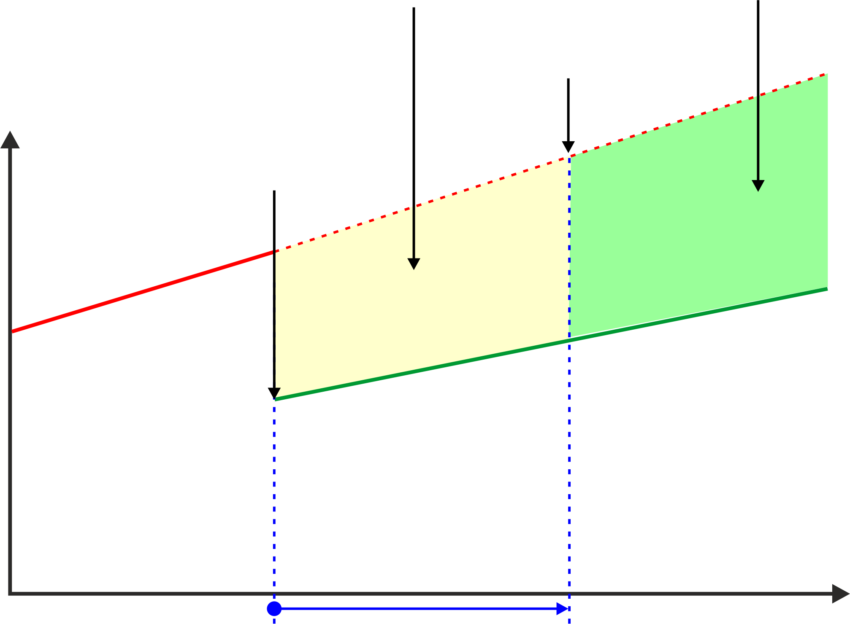
The owner of a building invests in EE improvements of a building on the basis of an EPC business model
Continuous energy cost savings of the building owner
Saved energy cost used for the repayment of the investment and the contracting fees of the energy service provider
Energy efficiency investment with an EPC with guaranteed energy savings
End of EPC contract (investment paid back)
Energy cost prior to EE investment
Actual energy cost
Energy cost after EE investment
Source: GIZ
EPC contract period
time

Slide 4
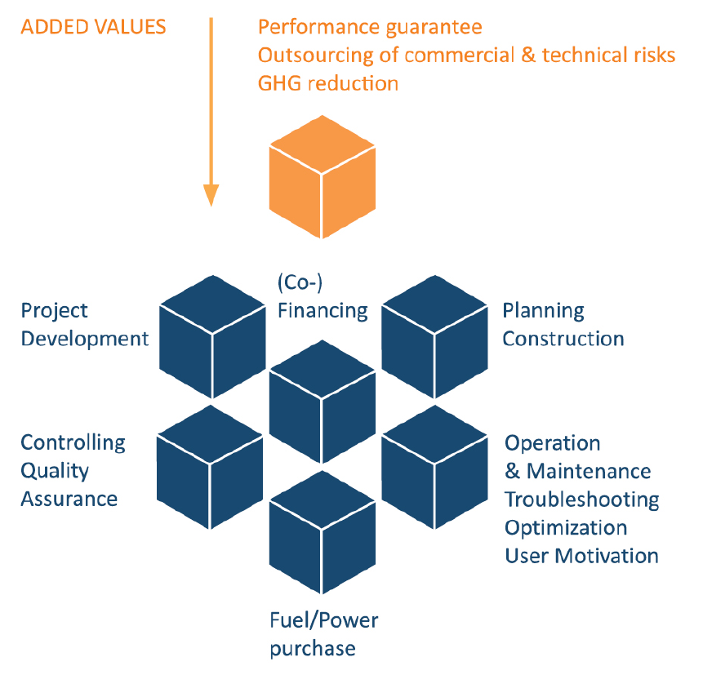
An Energy Service Provider (or Energy Service Company – ESCO) implements a customized energy service package, consisting of planning, building, operation & maintenance, (co-) financing and optimizing user behaviour.
The contract between the ESCO and the building owner contains guarantees for energy savings and the ESCO takes over some form of financial and technical risk of implementation and operation for the entire project duration.
The service or parts of it is paid for by realized energy cost savings.
Source: EESI 2010

Slide 5
Major advantages of EPC compared to traditional owner-directed ways of project implementation are:
In the case in which the ESCO also finances the investment, the building owner does not use own funds and transfers its investment risk to the ESCO.
EPC improves energy efficiency and thus also increases operating reliability and security of supply, while energy costs and environmental pollution are reduced.
The ESCO's technical know-how and professional energy management are used.
The building owner is relieved of essential planning and operating work. More time remains for its own core tasks.
Value, productivity and comfort of buildings are enhanced.
The full set of services like e.g. planning, financing, construction, operation, and maintenance may be covered from one source, thus reducing the number of interfaces and transaction cost.
Additional services such as user motivation and trainings can be included within the scope of the EPC.
Contract elements assign, to a large extent, commercial and technical risks to the ESCO´s.

Slide 6
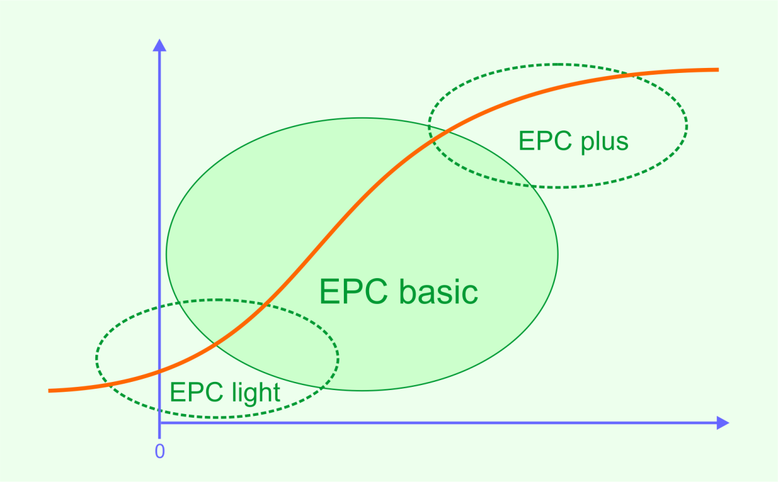
Guaranteed energy savings (compared to baseline)
No investment (prior to investment stage)
Planned investments

Slide 7
 | EPC light | EPC basic | EPC Plus
Scope of investment | Only equipment and operating costs. | Investments only in faster-paying energy saving measures. | Investments in comprehensive rehabilitation (deep renovation) of buildings including non-energy related measures.
Energy savings achieved | Typically < 20 % | Typically 20-50% | ideally >50%
Contract duration | In most cases 2-3 years | In most cases 5-15 years | Often >15 years
State of building and planned investment | All public buildings with energy saving potentials. | The building still serves its purpose, but energy systems installed and used in the building are outdated and inefficient. | Building does no longer serve its (current or future) purpose. Building and installed energy systems are outdated and/or dysfunctional, deep renovation is planned.
Design and planning of the EPC project | Building owners or local facilitators. | Building owners or local facilitators. | Building owners or local facilitators.in cooperation with contracted architects, and engineers.

Slide 8
 | EPC light | EPC basic | EPC Plus
Ownership of installations | All installations property of the building owner. | Ownership of all equipment and facilities installed in a building is usually transferred to the building owner at the date of acceptance as stipulated in the contract.
Services (operations) included in the scope of a project. | Management services: Energy accounting and management. Verification of energy bills. Measurement of actual energy consumption and verification of achieved energy savings. Grant applications and approval procedures. Operational services: Optimisation of operation and maintenance. Sometimes additional: auditing and certification procedures.
Financing | Financing by client, staff costs provided by ESCO. | ESCOs own equity, loans, subsidies, financial contributions from the client.
Pay-back of investment | Completely from guaranteed energy savings. |  | Partially from guaranteed energy savings. The remaining share paid separately (e.g. up-front).

Slide 9
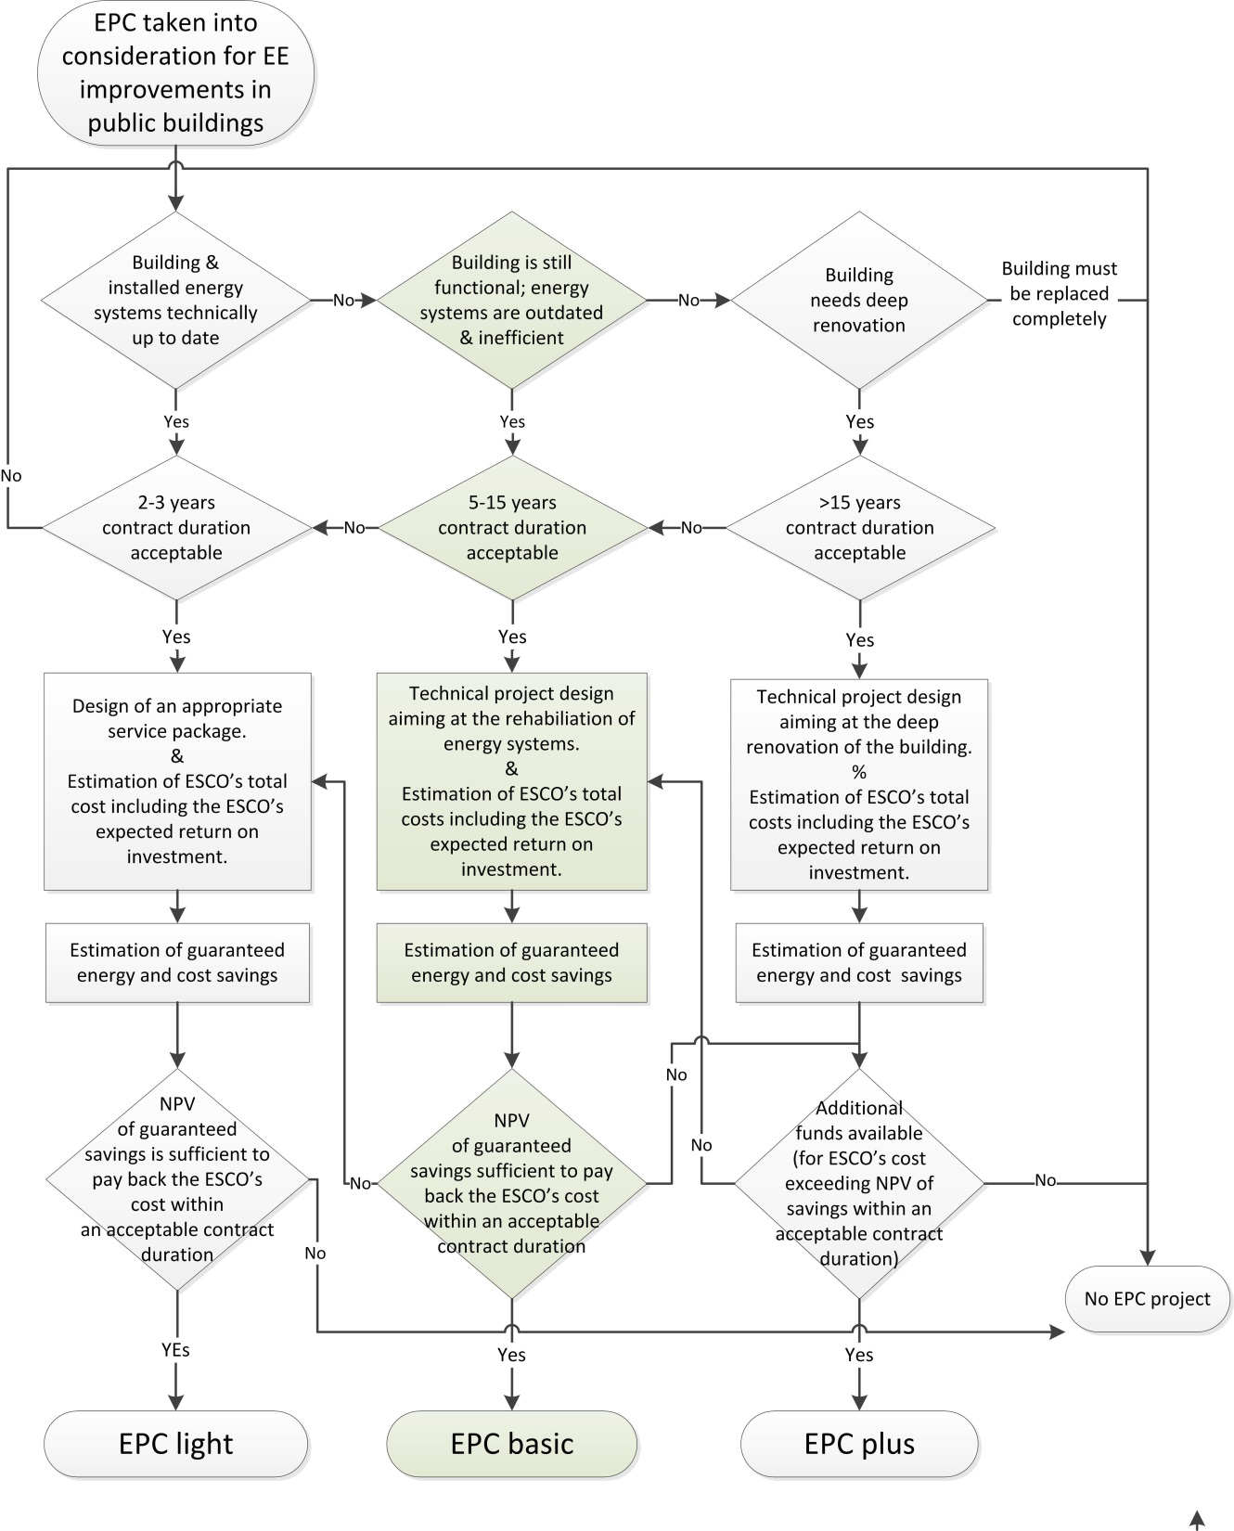
Selection of EPC projects and of appropriate EPC business models

Slide 10
Economic assessment of EPC projects can be either on:
Net present value (NPV) method comparing total life cycle cost and savings:
Discounting all project cost and savings expected during the entire life cycle of the project to the moment of project start.
Comparing NPVs of total life cycle cost and savings.
Annuity method comparing equivalent annual cost and savings:
Calculating the equivalent annual cost of the project based on the annuity of initial cost (preparation, planning, investment etc.) plus annual implementation cost.
Comparing equivalent annual cost and guaranteed savings.

Slide 11
Based on the Annuity method, the major economic constraints for EPC projects may be summarized as follows:
If the total cost of an EPC project (including the fees of the ESCO) shall be paid completely from future savings, the equivalent annual cost (minus subsidies) must not exceed the average annual future savings (minus additional cost) during contract duration.
If the equivalent annual cost (minus subsidies) is higher than the average annual future savings (minus additional cost) during contract duration then the total cost of the EPC project (including the fees of the ESCO) can be paid only in part from future savings.

Slide 12
Based on the NPV method, the major economic constraints for EPC projects may be summarized as follows:
If the total cost of an EPC project shall be paid completely from future savings, the net present value of total project life cycle cost (minus subsidies) must not exceed the net present value of future savings (minus additional cost) accumulated during contract duration.
If the net present value (NPV) of total project life cycle cost (minus subsidies) is higher than the net present value of future savings (minus additional cost) accumulated during contract duration, the total cost of an EPC project can be paid only in part from future savings.

Slide 13
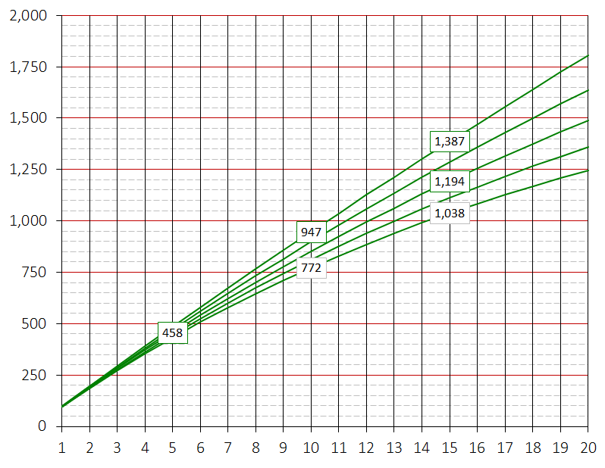
Guaranteed savings: 100,000 € per year
Discount rate: 1%
Discount rate: 2%
Discount rate: 3%
Discount rate: 4%
Discount rate: 5%
Accumulated NPV of future savings (in 1,000 €)
Number of years of contract duration

Slide 14
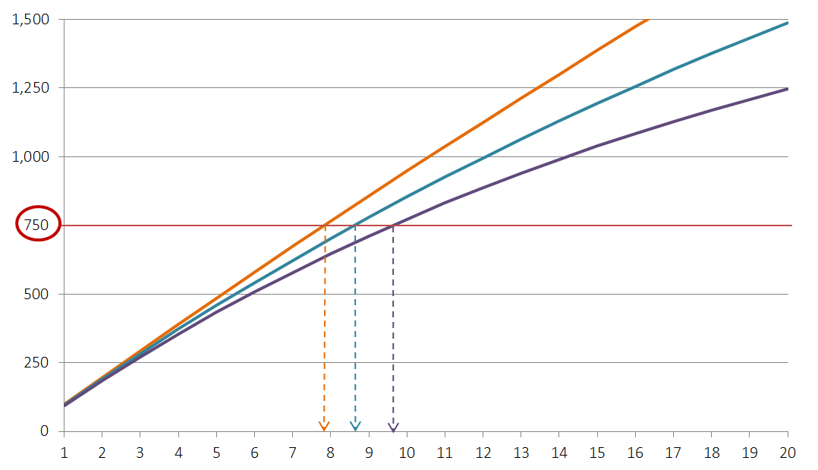
Total cost o the project (NPV) : 750,000 € Guaranteed savings: 100,000 € per year
Accumulated NPV of guaranteed savings Discount rate: 1%
Discount rate: 3%
Discount rate: 5%
Total project cost (NPV in 1,000 €)
Accumulated NPV of future savings (in 1,000 €)
Contract duration

Slide 15
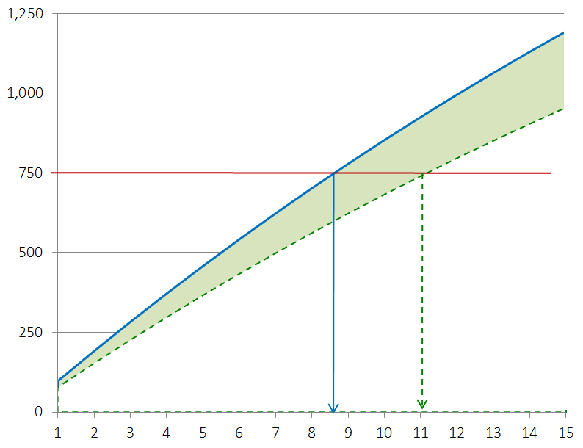
Guaranteed savings: 100,000 € per year
Accumulated NPV of guaranteed savings Discount rate: 3%
Total project cost (NPV in 1,000 €)
Building owner takes 20% of the guaranteed savings on its own account during contract duration.
Accumulated NPV of future savings (NPV in 1000 €)
Pronlongation of necessary contract duration
Necessary contract duration (in years)

Slide 16
Contact us!
For any inquires or comments, please don’t hesitate to contact us
www.meetmed.org meetMED Project
@meetmed1

