Slide 1
Tendering and Contracting
Aristotelis Botzios-Valaskakis
Senior Expert, Centre for Renewable Energy Sources and Energy Saving
meetMED II
Activity 3.1.2 Training Seminar
“Fundamentals of Energy Services and Energy Performance Contracting”

Slide 2
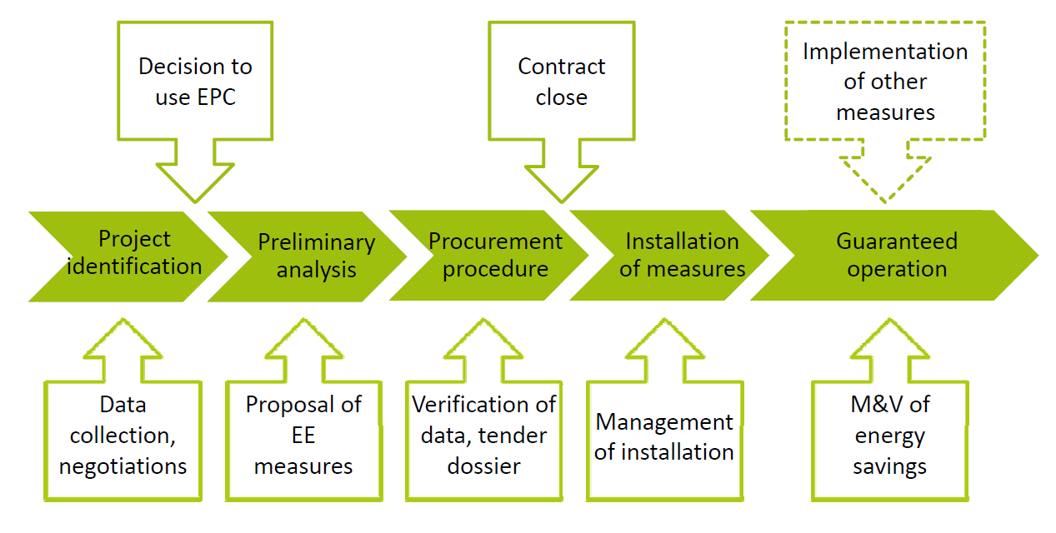
Main stages of an EPC project:
Tendering and contracting of EPC services
Source of the underlying chart: Transparense.eu

Slide 3
In the public sector, the procurement procedure must always be in compliance with the national public procurement legislation (based on the EU Public Sector Directive 2004/18/EC, resp. 2014/24/EU).
Whereas EPC light may usually be treated in standard procedures applied for the award of public service contracts, EPC basic and EPC plus business models are more complex and usually include all three types of public contracts:
Public supply contract
Public works contract
Public service contract
The following slides focus on tendering procedures and documents useful for EPC basic and EPC plus business models.

Slide 4
Single-stage process (no negotiations acceptable)
Setting up of project control committee / Selection of buildings
Contracting local facilitators
recommended
Project preparations
More detailed project elaboration: Evaluation of Building data Determination of energy costs baseline Fine analysis or energy situation of the building Detailed project planning Determination minimum saving guarantee requested
Compilation of tender dossier Project-specific adjustment of the EPC contract template
Publication of contract notice Expression of interest from ESCOs
Selection of 3-10 qualified bidders (short list)
Supporting the build owner (project control committee), or acting on its behalf
if no qualified bidder among expressions of interest
Cancellation of the tendering procedure
Request for tenders
Invitation to tender and award of contracts
Tender preparation by ESCOs Including: Inspection of the buildings & validation of data from the tender dossier More detailed analysis with regard to energy situation of the building Detailed project planning Determination of offered saving guarantee, contract duration, and fees
Presentation of bids by ESCOs Evaluation of bids Selection of the most economic offer and comparison with non-EPC options
if no economic offer, or if decision against EPC
Cancellation of the tendering procedure
Signature of the EPC contract Planning, guarantees, implementation,

Slide 5
Single-stage negotiated process
Setting up of project control committee / Selection of buildings
Contracting local facilitators
recommended
Project preparations
Evaluation of Building data Determination of energy costs baseline Determination minimum saving guarantee requested
Compilation of tender dossier Project-specific adjustment of the EPC contract template
Publication of contract notice Expression of interest from ESCOs
Selection of 3-10 qualified bidders (short list)
if no qualified bidder among expressions of interest
Cancellation of the tendering procedure
Request for tenders
Supporting the build owner (project control committee), or acting on its behalf
Tender preparation by ESCOs including: Inspection of the buildings & validation of building data Rough analysis with regard to energy situation of the building Determination of energy and cost savings potentials
Invitation to tender and award of contracts
Presentation of bids by ESCOs Evaluation of bids Invitation of 2-4 best bidders for contract negotiations
Contract negotiations Selection of the most economic offer and comparison with non-EPC options
if no economic offer, or if decision against EPC
Cancellation of the tendering procedure
Signature of the EPC contract Planning, guarantees, implementation,

Slide 6
Two-stage negotiated process
Setting up of project control committee Selection of buildings
Contracting local facilitators
Project preparations
recommended
Evaluation of Building data Determination of energy costs baseline Determination minimum saving guarantee requested
Compilation of tender dossier Project-specific adjustment of the EPC contract template
Publication of contract notice Expression of interest from ESCOs
Selection of 3-10 qualified bidders (short list)
if no qualified bidder
Cancellation of the tendering procedure
Invitation to tender, rough analysis, award of contract
Supporting the build owner (project control committee), or acting on its behalf
Request for tenders
Tender preparation based on rough analysis and submission by ESCOs Vetting and assessment of tenders Negotiations & selection of most economic offer
if no economic offer
Cancellation of the tendering procedure
Contract stage 1: Project planning contract
Stage 1: Fine analysis with regard to energy Detailed validation of potential energy and cost savings
Fine analysis Start of Stage 2 of contract
Comparison of results, final decision of client
Cancellation of the tendering procedure Compensation for planning cost
Non-confirmation of rough an analysis, or
confirmation, but decision against EPC
Contract Stage 2: Implementation of EPC

Slide 7
Negotiations yes/no ?
NO negotiations necessary:
Measures can be described very detailed.
Small projects.
YES, negotiations preferred:
Complex project structure (as in most of EPC projects).
Clarification of technical or economic details not completely possible prior to the ESCOs‘ presentation of bid.
One-stage/two-stage process?
One-stage:
Scope of measures clearly defined in the tender documents.
No alternative measures allowed to be proposed in the bids.
Two-stage:
Only project objectives and some core (mandatory) measures defined in the tender documents.
Detailed and optimized overall scope of measures to be proposed by the bidders.

Slide 8
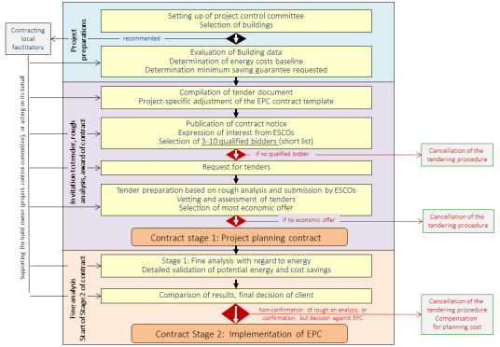
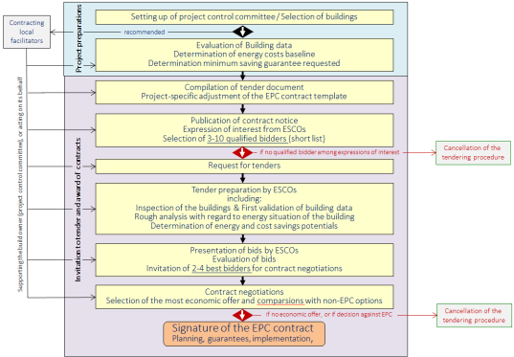
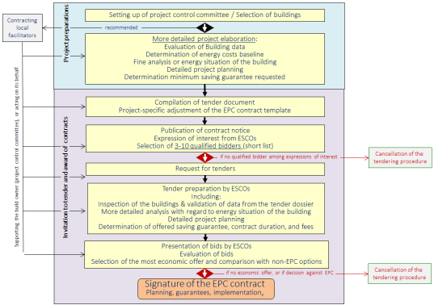
Model procedure |  | Advantages | Disadvantages
Two-stage negotiated process |  | Little project preparation effort prior to entering into the tendering stage Detailed planning performed by the ESCO during first contract phase. Little up-front cost to be paid by the building owner. | High effort for the management of the tendering process Weak criteria for the selection of the best project concept at the first tendering stage (a lot of space for debate among experts and decision makers).
Single-stage negotiated process |  | Risk of project failure is minimized. | Higher project preparation effort and more up-front decisions on project details required prior to entering into the tendering stage in order to ensure comparability of tenders Higher up-front cost of the project.
Single-stage no negotiations |  | Ready-to-implement project plans including detailed specifications of facilities, equipment and services to be delivered. | Very high project preparation cost High risk of a call failure (no acceptable tender received), if no ESCO agrees fully with the project concept set out in the tender dossier, as there is no space for negotiations or for alternative tenders provided in the tender dossier.

Slide 9
Contracting local facilitators
Local facilitators may support all process steps from project identification to contract signature, as well as the monitoring and evaluation of ESCO services and of achieved energy savings.
Local facilitators may be:
Local or regional energy agencies
Engineering offices
Legal advisers
Architects
Economists
They should have a sound knowledge and understanding of:
Techniques and economics of EE in buildings
Public procurement procedures and codes of conduct
EPC concepts and business models
Local energy agencies, if financed by municipalities’ membership fees may sometimes be involved without any tendering.
Contracting of commercial local facilitators has usually to follow standard services procurement procedures.

Slide 10
Compilation of tender dossier Project-specific adjustment of the EPC contract template
The content of the tender dossier should include:
Key requirements
Minimum share of savings on the energy consumption/energy costs
Obligatory and/or recommended energy efficiency measures
Information whether and under which conditions the ESCO is required to provide financing
Deadline for the expiration of EPC contract
Formal requirements for tender
Organisational aspects
What tasks should be carried out by the ESCO and by the client?
Contract terms and conditions
Exact definition of the contractual relationship
Technical aspects
Description of the buildings,
Energy statistics (copies of invoices, data on energy consumption and cost min. 3 years back )
Calculation method for a baseline energy consumption
Operation times, equipment, building use, required indoor climate (temperature, ventilation etc.)
Current energy systems and energy management in place

Slide 11
Publication of contract notice / Expression of interest from ESCOs
Selection of 3-10 qualified bidders (short list)
Selection criteria for the identification of suitable tenderers
3-5 ESCO will be invited to submit their tenders. If more than 5 ESCOs submit their applications, transparent selection criteria must be applied, such as e.g. :
Qualification criteria, for example:
Economic capacity of the ESCO measured in turnover in energy services and in particular in EPC.
Number and relevance of (up to 5) own reference projects based on ESCO/EPC business models.
Eligibility criteria, for example:
Professional or trade register extract
Proof of liability insurance (with minimum coverage level)
Legally required licenses and certificates
Corporate structure (legal status, statutes, shareholders)
Declaration concerning payment of legal taxes and duties
Number of employees (e.g. during the past 3 years)
Economic, technical, and financial capacities.
Clear information on the selection criteria and ratings must be included in the tender dossier, resp. in the Call for Expressions of Interest.

Slide 12
Tendering process step | Duration (source: KEA)
Preparation of tender dossiers | 1-3 months
Publication of the contract notice and invitation of expressions of interest | -
Call for expressions of interest and selection of tenderers | 1.5-2 months
Notification of shortlisted tenderers and invitation to tender | -
Tender preparation and tenderers‘ rough analysis of the project | 2-4 months
Evaluation of tenders, negotiations with best tenderers, selection of the winning tender | 1-1.5 months
Economic comparison of the EPC with standard solutions (own implementation) | 0.5 months
Selection of the winning tender and awarding meeting of the local council | 0.5 months
Approval of the supervising authority Notification of the winning tenderer of the award of contract, and contract signature | 1-3 months
Fine analysis including detailed planning of the project by the contractor | 2-4 months
Review, revision if necessary, and approval of the results of the final analysis | 1-2 months
Implementation of agreed measures and installation of facilities | 4-12 months
Total duration from the start of preparation of tender dossier to project implementation | 10-20 months

Slide 13
Contact us!
For any inquires or comments, please don’t hesitate to contact us
www.meetmed.org meetMED Project
@meetmed1

