Slide 1
Plenary Session 3: Concerted Action on Appliances Technicalities of Efficient Appliances
Ahmed Khalil, WP4 Leader, RCREEE
Ahmed.khalil@rcreee.org
meetMED Week
30 March 2022

Slide 2
Key Pillars for Efficient Appliances
Efficient Appliances Market
(S&L Programs and MEPs)
Market Demand
Cost Benefits
Quality Infrastructure
Trade Facilitation
Policies and Regulations
Consumer Confidence and Awareness

Slide 3
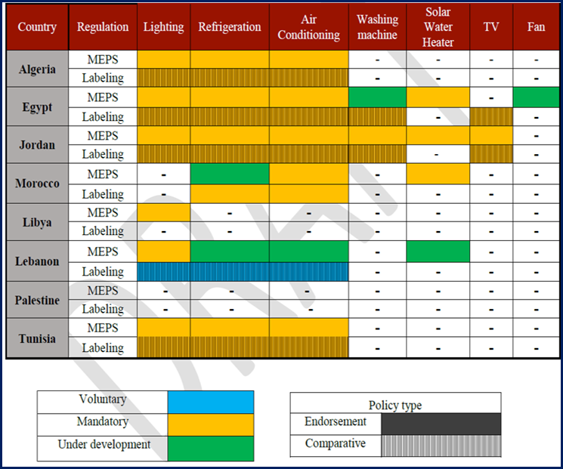
Country Key findings

Slide 4
Country Key findings
Only three out of the eight countries have a lab accreditation bodies.
Expansion of regional and international trade supports dissemination of energy-efficient appliances in different countries including in those lacking clear energy efficiency targets and regulations.
The absence of such regulations leaves regional markets vulnerable to importation of inefficient devices and delays the establishment/enforcement of quality regulation related to regionally manufactured household appliances.
The lack of regional energy efficiency MEPS and labeling programs limits consumers’ choice as a viable market tool. In combination, these factors lead to spread low energy-efficient equipment all over the region.

Slide 5
Header section title
THANK YOU

Slide 6
Contact us!
For any inquires or comments, please don’t hesitate to contact us
www.meetmed.org meetMED Project
@meetmed1

