Slide 1
meetMED II - Access to Finance
Sustainable Energy Investment Forum
Dr. Maged Mahmoud
Technical Director,
Regional Center for Renewable Energy and Energy Efficiency (RCREEE)

Slide 2
meetMED II Access to Finance (WP5) Objectives
28 March 2022
Sustainable Energy Investment Forum
The objective of Work Package 5 is to facilitate access to finance for efficient buildings and equipment through
facilitating dialogue between banks, financial partners, institutions, public and private operators,
improving the visibility of existing funds,
creating innovative mechanisms for funding projects in this field (buildings & appliances).
assisting project holders to get access to finance with a focus on public buildings, tertiary, and industrial sectors.

Slide 3
28 March 2022
Sustainable Energy Investment Forum
Key Intervention Areas
Finance Business Models
MED-SEI Forums and Finance Round Tables
Webtools for Project Owners
Training Modules for Banks

Slide 4
28 March 2022
Sustainable Energy Investment Forum
Financing capabilities guidebook
Design of 3 effective business models for appliances and buildings
4 capacity development activities in 4 countries
4 events with IFI’s and other actors on Business Models
Report on climate innovative finance
Finance Business Models
Key Deliverables

Slide 5
28 March 2022
Sustainable Energy Investment Forum
Webtools for Project Owners
Mapping existing tools and guidelines
Stocktaking of ongoing initiatives, incentives, etc.
National and Regional consultations
Webtools / Platform conceptual design
Deployment and Marketing of Webtools
Key Deliverables

Slide 6
28 March 2022
Sustainable Energy Investment Forum
Modules for Banks
Training module development on “EE Labels and MEPs”
Training module development on “Green Buildings”
Training module development on “New and Innovative Financing Schemes”
4 Capacity development programs in 4 countries
Key Deliverables

Slide 7
28 March 2022
Sustainable Energy Investment Forum
Key Deliverables
MED-SEI Forums and Finance Round Tables
National contact points and networks of experts
8 National Forums
3 Regional Forums with meetMED Weeks

Slide 8
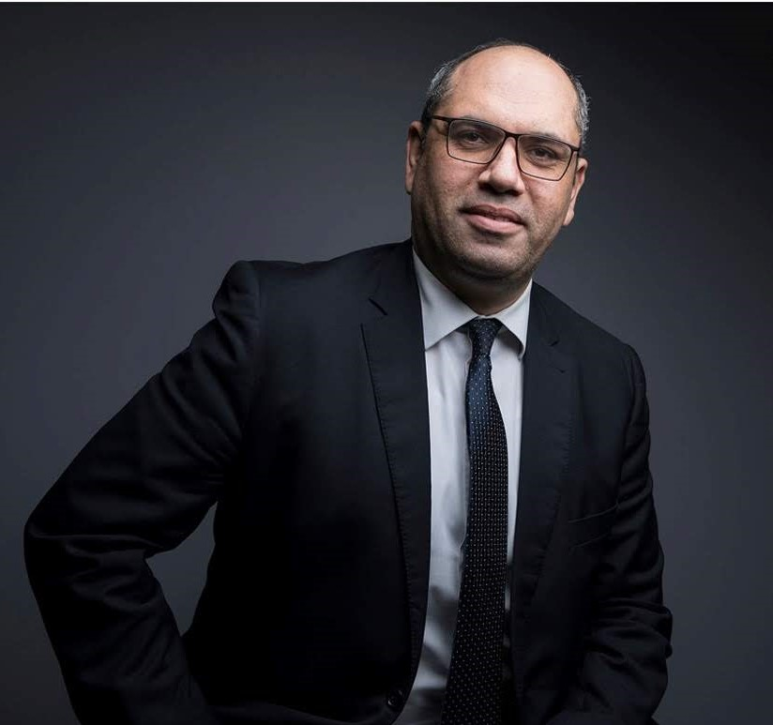
28 March 2022
Sustainable Energy Investment Forum
Thank You
Dr. Maged K. Mahmoud
Technical Director, Lead Expert
Regional Center for Renewable Energy and Energy Efficiency (RCREEE) Hydro Power Building (7th Floor)
Block 11 - Piece 15, Melsa District
Ard El Golf, Nasr City, Cairo, Egypt maged.mahmoud@rcreee.org
www.rcreee.org

