Slide 1
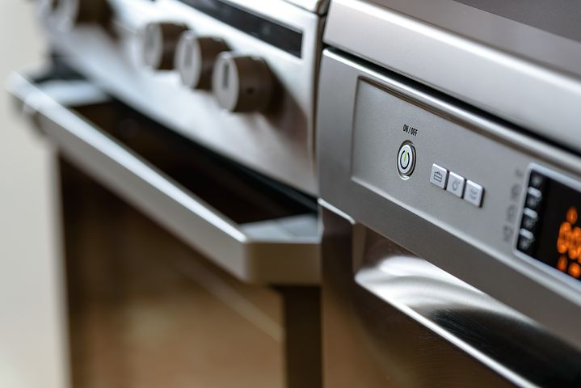
Overview of the WP2
Concerted Action on Appliances
30 March 2022
Objectives:
To enhance and structure the sharing of information and experiences, and promoting good practices of policy measures in buildings and appliances sectors.
To develop and implement capacity building programs.
To promote and disseminate the outcomes of the activities held in other WPs.
Timeframe :
Year 1
Year 2
Year 3
Year 4
Engagement
meetMED weeks
Interactive website
Support to decision makers in building sector
Support to decision makers in appliances sector
Support on monitoring / Set up a regional EE observatory
Technical working groups
Final outputs :
3 publications;
Training modules and databases
Roadmaps and involvement of relevant stakeholders

Slide 2
Concerted Action on Appliances
Tasks :
Expected impacts :
2.1. Engagement and dissemination activities
(Coordinator of the activity: ENEA)
Aim: Enhance and structure the sharing of information and experiences and good practices in the Region, as preliminary steps to improve the enforcement of relevant energy policy measures in buildings and appliances sectors.
2.2. Support to policy / decision makers on harmonization of legislation, regulations and standards in buildings’ sector
(Coordinator of the activity: ADENE)
Aim: Facilitate dialogue and sharing of experiences for enforcing EEBC and EE measures in buildings with support of the meetMED REN task force on EE in Buildings.
2.3. Support to policy / decision makers on harmonization of legislation, regulations and standards in appliances’ sector
(Coordinator of the activity: RCREEE)
Aim: Facilitate dialogue and sharing of experiences for enforcing MEPS and efficient appliances with support of the meetMED REN task force on appliances.
2.4. Support to policy/decision makers on Monitoring and Evaluation (with a focus on buildings and appliances)
(Coordinator of the activity: ADEME)
Aim: To implement a common Regional Energy Observatory Database on energy efficiency indicators and complete / update data on buildings and appliances, in order to follow up NEEAPs and national strategies’ implementation.
Mapping and engagement of all the relevant public and private stakeholders by target country
Establishment of a permanent and high-level international forum of discussion and exchange of information, experiences and good practices
At least 10 policies adjusted and tested in the 8 targeted countries
3 publications and favorable conditions to fasten the convergence of national procedures on EE in buildings and appliances related matters.
A national monitoring system established at national level for evaluating energy efficiency policy impacts and energy saving calculations in particular for the building sector and electrical appliances.
Exchange on information of practices on energy modelling practices and NEEAP development and implementation.

Slide 3
Concerted Action on Appliances
Technical working groups:
Concerted Action on Buildings :
Energy Efficiency Building Codes
Building Renovation
Labelling and Training
Financing
Concerted Action on Appliances :
MEPS and standards
Market surveillance and testing
Scrapping campaigns
Awareness raising and training
Financing
Monitoring & Evaluation :
Energy efficiency indicators implementation
Energy demand modelling and prospective tools
NEEAPs and national strategies implementation
Specific Energy Efficiency indicators in buildings and appliances

