Slide 1
MED Sustainable Energy Investment Forums
28 March 2022
MED SEI Forums
Boost investment and financing for energy efficiency at the national level
activate private-sector investments
enhance access to finance for energy efficiency projects
help replicate and scale up best practices and innovative approaches
Map and engage all relevant public and private stakeholders by country
Map relevant financial tools, measures, initiatives by country
Identify projects to be funded
Establish a permanent and high-level national forum of discussion and exchange of information, experiences and good practices

Slide 2
MED Sustainable Energy Investment Forums
28 March 2022
National roundtables organized within both the MEETMED WEEKS and NATIONAL EVENTS to:
facilitate dialogue between banks, financial partners, public authorities and all stakeholders involved in delivering investments in sustainable energy
improve the visibility of existing funds
present good practices and innovative funding mechanisms addressed to both buildings and appliances
identify barriers and single out the enabling conditions and necessary amendments in the legal framework to enabling a conducive business environment
NATIONAL EVENTS
3 within the meetMED weeks
5 within other national events

Slide 3
NEXT STEPS
MED Sustainable Energy Investment Forums
Stakeholders’ identification in targeted countries
Selection of National Contact Points and network of experts within each country
Data and information collection
Communication & networking activities with stakeholders for discussing their expectations and proposed input for national roundtables
Selection of the host country
Algeria, Egypt, Jordan, Lebanon, Libya, Morocco, Palestine, Tunisia
Interviews with key stakeholders
CANDIDATURES ARE OPEN – CONTACT US

Slide 4
MED Sustainable Energy Investment Forums
Taking inspiration from the European experiences
Sustainable Energy Investment Forum
Energy Efficiency Financial Institutions Group (EEFIG)
National roundtable on financing energy efficiency

Slide 5
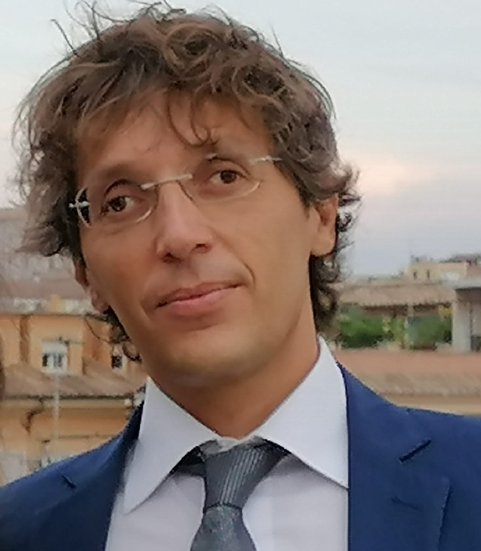
MED Sustainable Energy Investment Forums
28 March 2022
THANK YOU
Dr. Edoardo Pandolfi
Energy Efficiency Unit Department
Italian National Agency for New Technologies, Energy and Sustainable Economic Development
Lungotevere Thaon di Revel, 76 00196 Rome, Italy
edoardo.pandolfi@enea.it
www.enea.it

