Slide 1
WP4: Promote Efficient Appliances & Develop the Market
Ahmed Khalil, WP 4 Leader, RCREEE
Ahmed.khalil@rcreee.org
meetMED Week
30 March 2022

Slide 2
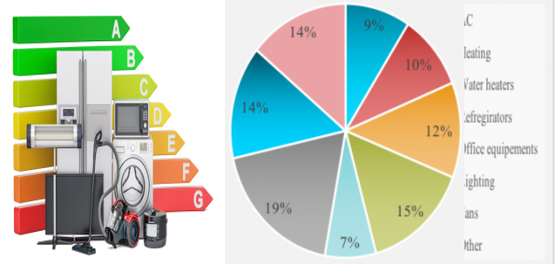
1. Key Findings from meetMED-I
Electricity consumption trends as per the findings from the MeetMED-I project showed that Residential sector consumes ~42% of the total end electricity use in the SEMCs.
Appliances contribute to 70% ~ 80% of the total residential consumption in the region.
Moreover, there is still variance in the maturity of implementation of Appliances regulations, standards and best practices within different countries in the region.
Key identified challenges to the promotion of
efficient appliances include:
- Need for supporting policies;
- Implementation of MVE;
- Cost of Efficient appliances;
- Public Awareness; and
MeetMED-I Takeaways

Slide 3
2. WP4 in few words : Promote Efficient Appliances & Develop the Market
WP4 Objectives
WP4 focuses on promoting the use of energy efficient appliances in the SEM Countries in order to help in the global energy security & contributes to economical growth.
The time plan for implementation of WP4 is Jan 2021 → June 2024 the project’s life time (~ 3.5 yrs).
The main design concept was to focus on Practical on-ground Implementation and that is why WP4 consists of 2 main Pillars:
Demo Actions & Projects.
Capacity Development Activities
Develop Procedures for MEPS & Labels for EE Appliances
Appliances Scrapping Campaigns & Awareness Campaigns
Capacity Building for Professionals and Public Officers
Increase regional testing Capacities & Harmonize MEPS & labels
Promote the market of Efficient Equipment

Slide 4
3. WP4 Deliverables & Expected Outputs
4.1. Demo Actions Deliverables
4.1.1 Appliances Scrapping Campaigns
4.1.2 Feasibility of Regional Testing Centre
4.2. Professional Capacity Building Deliverables
4.2.1 Training Tours & Visits
4.2.2 Increase Visibility of Efficient Appliances Guidelines among Professionals
4.1.3 Regional Manual for MEPS Implementations Procedures
4.1.3 Promotion of MEPS & Labelling Processes
(Focus on AC)
4.1.1 Create National Task Forces
4.1.1 Scrapping Campaigns Manuals
4.1.3 National MEPS Programs Reports
4.1.3 Regional Report on MEPS & Labels Implementation
4.1.1 Awareness Campaigns
4.1.2 Feasibility Study for a Regional Testing Facility
- Small power Equip. (Appliances)
- Heavy Equipment (Motors)
-Building Materials (Envelope)
4.2.2 Design of guidelines Brochures for professionals
4.2.1 Develop Training Modules
(Physically & Virtually)

Slide 5
Header section title
THANK YOU

Slide 6
Contact us!
For any inquires or comments, please don’t hesitate to contact us
www.meetmed.org meetMED Project
@meetmed1

