Slide 1
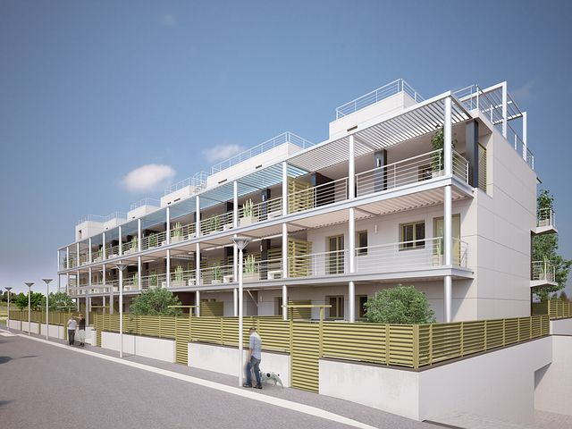
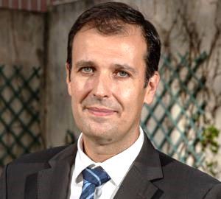
Concerted Action on Buildings
29 March 2022
Rui FRAGOSO/ ADENE (Portugal) / meetMED / T2.2 leader
WP2 – Strategies and policies - dialog and monitoring
Involved target countries: Algeria, Egypt, Jordan, Libya, Lebanon, Morocco, Palestine, Tunisia
Goal: Support to policy / decision makers on harmonization of legislation, regulations and standards in buildings’ sector
Main activities: Establishment of 4 technical working groups; follow-up WP3, WP5 and WP6 (review and technical inputs)
Expected results: Develop guidelines and best practices on energy efficiency measures in buildings

Slide 2
Structure of all activity
Based on the experience from European Union Concerted Actions
Enhance and structure sharing of information and experience from national implementation and promote good practice in activities required of Member States
To encourage dialogue between Member States on common approaches for the effective implementation of particular parts of those directives

Slide 3
Structure of all activity
Coordination team with experience from participating and managing different topics at different EU concerted actions and leading different topics
Experts from 8 countries with expertise in different areas in their countries/agencies
Leading team
4 Technical Working Groups (WG)
Experts
[From 5 countries so far]
WG1 - Energy Efficiency Building Codes
WG3 - (buildings) Labelling and (experts) Training
17 experts
Cláudia Monteiro
14 experts
15 experts
WG2 - Building Renovation
WG4 - Financing
14 experts
Anna Maria Sàlama

Slide 4
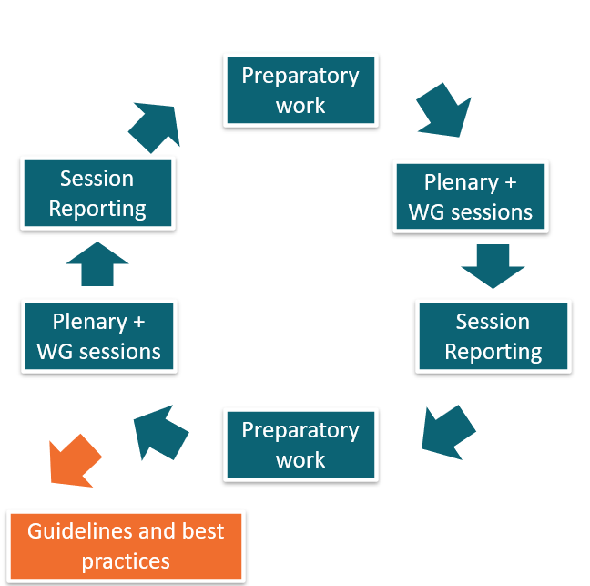
Methodology and Action Plan
Workflow
Tools
Prepare to present results from existing initiatives (best practices)
Perform questions and surveys
Develop small studies
Interviews
Invitation to external speakers
Setup additional topics / working groups
Ad-hoc meetings/webinars

Slide 5
Deliverables and indicators
D2.2 TASK FORCE NOTES
Organization of the regional annual seminars, including the event, concept note and agenda.
meetMED country experts present data and case studies at the regional annual seminars.
Reports with summary of session results
D2.2 INDICATORS
Number of relevant policies and measures proposed to national authorities for adoption
At least 10 policies proposed for implementation in 8 countries
D2.2 GUIDELINES AND BEST PRACTICES ON ENERGY EFFICIENCY MEASURES IN BUILDINGS
Core team will draft the guidelines on energy efficiency measures based on the results of the working groups.
meetMED country experts will review and contribute to the guidelines on energy efficiency measures.
(On-going) document embedding the findings from task 2.2

Slide 6
Concerted Action on Buildings
29 March 2022
First achievements
1st meeting – November 2021 - Introduction to Work Package 2 Activities & Outcomes
Identification of team of experts from each target country
Mapping of topics for discussion and level of interest from target countries
Next steps
Conclude list of experts (still 3 country remaining)
Further mapping of legislation, regulations, standards and practices within each of the 4 WG
Identify specific needs from each target county
Start mapping (as a 1st approach) which policies can be proposed for each target country

