Slide 1
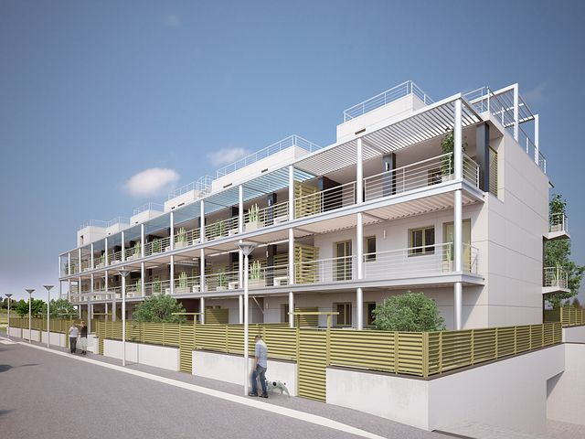
Concerted Action on Buildings
29 March 2022
TWG 2- Building Renovation
National legislative provisions and/or national programs/plans on energy transition and decarbonization for the building sector (including governance
Vulnerable dwellers and building renovation + Post-COVID-19 measures
Supporting actions for the above, such as : scholar and higher education programs, training and awareness plans for users, information campaigns…
Availability of technical/management competences o n energy efficiency (such as ESCOs’ staff, maintenance companies, etc.)
Anna M. Sàlama, ENEA – Italian National Agency for EE

Slide 2
Concerted Action on Buildings
29 March 2022
TWG 2- Building Renovation – Questionnaire Results
Anna M. Sàlama, ENEA – Italian National Agency for EE

Slide 3
Concerted Action on Buildings
29 March 2022
TWG 2 - Building Renovation
Case study 1 – TEESCHOOL,
Maria Anna Segreto/Mattia Ricci, ENEA (on-line)
Case study 2 – Promoting Energy Efficient Technologies
through Good Practices in Public Buildings,
Eng. Mohammad Mosleh, RSS Royal Scientific Society/ National Energy Research Center (RSS/ NERC) – Jordan
Anna M. Sàlama, ENEA – Italian National Agency for EE

Slide 4
Concerted Action on Buildings
29 March 2022
TWG4 - Financing
Current sources of financing for infrastructures and real estate investments in general, in particular for sustainable energy systems (for example incentives, legal obligations on existing or new); also for sustainable energy systems (, for example incentives, legal obligations on existing or new).
Financing of EE interventions for consumers in economic constraints.
Exemption/alleviation systems for socio-economic aspects (vulnerable users and/or in energy poverty?) and impact on consumption and the energy market.
Procedures of financial institutions for investments in EE (support by toolkits; platforms for de-risking analysis etc.);
Alignment between technical requirements for the feasibility of interventions and bankability procedures (ISO; taxonomy, etc).
Risk analysis in the evaluation of proposals for investments in EE.
Anna M. Sàlama, ENEA – Italian National Agency for EE

Slide 5
Concerted Action on Buildings
29 March 2022
TWG4 - Financing
Anna M. Sàlama, ENEA – Italian National Agency for EE

Slide 6
Concerted Action on Buildings
29 March 2022
TWG4 - Financing
Case study 1 – Energy Performance Contracts: Financing Opportunities and Challenges,
Aristotelis Botzios-Valaskakis, CRES (on-line)
Case study 2 – Energy transition fund: Financial tool for promoting EE, Abdelkader Babbouche, ANME
Anna M. Sàlama, ENEA – Italian National Agency for EE

