Slide 1
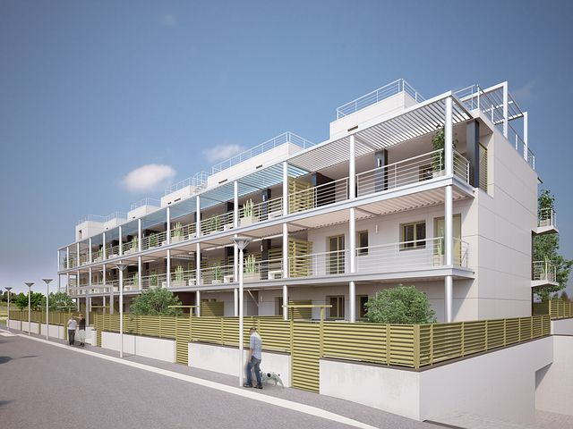
A2.2: Concerted Actions on Energy Efficiency in Buildings TWG2: Building Renovation
Case Study: Promoting Energy Efficient Technologies through Good Practices in Public Buildings
March 29th, 2022
Mohammad Musleh, Energy Specialist, RSS/NERC Jordan

Slide 2
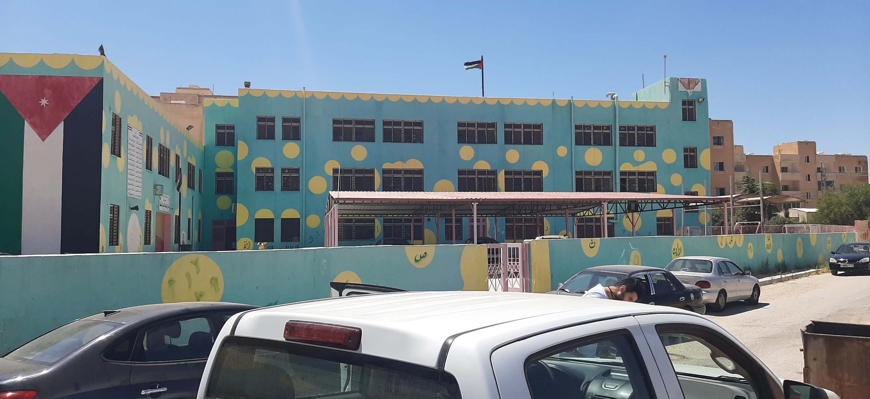
Concerted Action on Buildings
29 March 2022
Overview
Case Study: Iskan Faiha' primary mixed School. (Public School)
Location: Madaba is located south-west of the capital Amman.
Project: “SOLE” High Energy efficiency for the pubLIc stOck buildingS in Mediterranean
Project Partners: Italy, Greece, Egypt, Jordan, Lebanon, Spain, Tunisia
Timeline: September 2021 – February 2022
Budget: 250,000 Euro

Slide 3
Main Goals
Concerted Action on Buildings
29 March 2022
Enhance education environment and classrooms atmosphere.
Provide classrooms with required space heating and cooling in different seasons.
Reduce energy consumption of public schools and mitigate greenhouse gas emissions.
Disseminate the concept of energy and water management for students and the community.
Support and encourage students and local community to use clean energy.
Support and encourage students and local community to use clean energy.

Slide 4
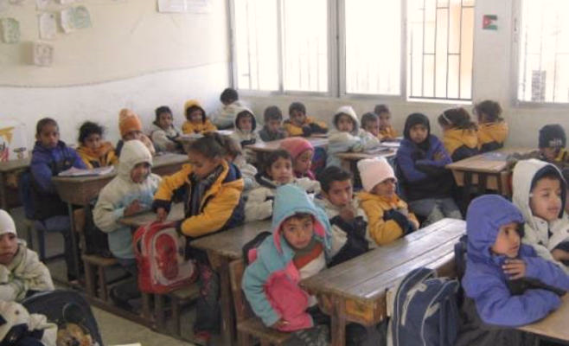
Concerted Action on Buildings
29 March 2022
Students Uncomfortable in cold weather

Slide 5
Project Stages
Concerted Action on Buildings
29 March 2022
Stage 1
Energy Assessments, HVAC & PV Designs and Economic analysis
Stage 2
Measures Selection
Stage 3
Implementation via local contractors
Bidding
RSS/NERC performed stages 1 & 2 and supervised stage 3 as the implementation was carried out via local contractors

Slide 6
Concerted Action on Buildings
29 March 2022
Main Figures
School Name | Land Area (m²) | No. of Buildings | No. of Classrooms | No. of Rooms | Number of Students | Working period
Location: North-West of Madaba
Iskan Faiha' primary mixed School | 2,930 | 1 | 30 | 41 | 725 | Morning

Slide 7
Concerted Action on Buildings
29 March 2022
Main Findings
Energy Consumption/ Electrical System
Estimated annual Electric Energy Consumption (kWh) | Estimated annual Electric Energy Cost (JOD) | Average Electric Tariff (JOD/kWh)
30,000 | 3000 | 0.1
Total Connected Load proportion

Slide 8
Concerted Action on Buildings
29 March 2022
Selected Energy Efficiency Measures
Replacing Lighting Units
Domestic hot water System
Thermal insulation external walls and roofs, double glaze with PVC frame
heating and cooling systems (AC split units)
Selected Renewable Energy Systems
Domestic hot water System
PV System (84 kWp)

Slide 9
Concerted Action on Buildings
29 March 2022
Selected Energy Efficiency Measures
Lighting system Retrofit
Replacing Lighting Units | No. of lamps | Connected load (Kw) | Annual Saving Cost (JOD)
Replace (Fluorescent tube 36w ) with (LED tube 18w) | 685 | 12.3 | 1315
Replace (CFL) with (LED round panel18W) | 60 | 1.1 | 58
Replace MH 250W with 50W | 6 | 0.3 | 90
Total |  | 13.7 | 1,463

Slide 10
Concerted Action on Buildings
29 March 2022
Selected Energy Efficiency Measures
Installing thermal insulation for external walls and roofs, double glaze with PVC frame
Component | Saving measure
External walls | Installing Polystyrene insulation panels (5 cm thickness) with gypsum boards as a covering material
Roof | Installing Polystyrene insulation panels (5 cm thickness) with tiles as a covering material
Windows | Replacing the existing windows with double glaze with PVC frame

Slide 11
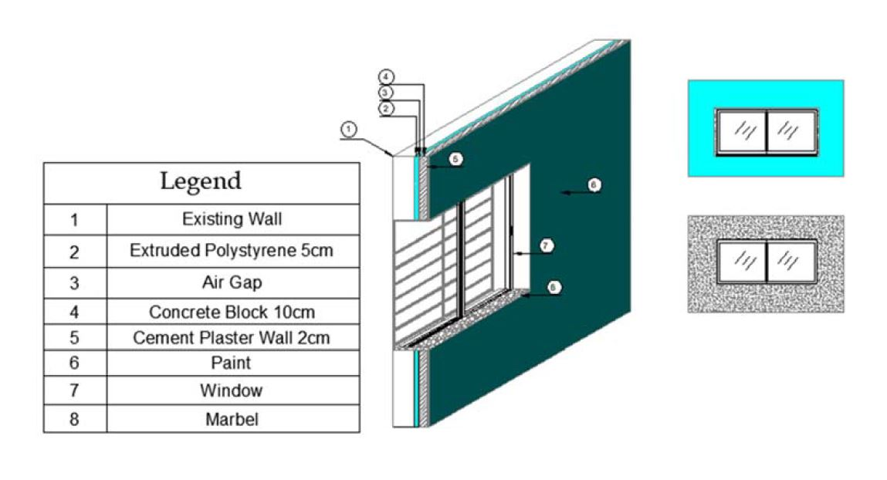
Concerted Action on Buildings
29 March 2022
Selected Energy Efficiency Measures
Installing thermal insulation for external walls and roofs, double glaze with PVC frame

Slide 12
Concerted Action on Buildings
29 March 2022
Selected Energy Efficiency Measures
Install Heating and cooling systems
Floor | GF | 1st | 2nd | Total | Expected annual consumption (Kwh/Year.)
Design cooling and heating capacities after implementing the saving measures of the building envelope (ton) | 24.5 | 30 | 20 | 74.5 | 107,127

Slide 13
Concerted Action on Buildings
29 March 2022
Renewable Energy Systems
Domestic Solar hot water System
Item | Description
Solar Thermal System Capacity | 1400 Lit/Day
System Type | Glazed flat plate collector
Required Free Space | 50 m²

Slide 14
Concerted Action on Buildings
29 March 2022
Renewable Energy Systems Potential
Photovoltaic System
Parameter | Value
System size | 84 kWp
System life expectancy | 20 years
Energy generation for the first year | 131,040 kWh
Annual system degradation | 1%
Average Tariff | 0.10 JD/kWh
First Year Saving cost (JD) | 13,104

Slide 15
Concerted Action on Buildings
29 March 2022
Renewable Energy Systems Potential
Photovoltaic System

Slide 16
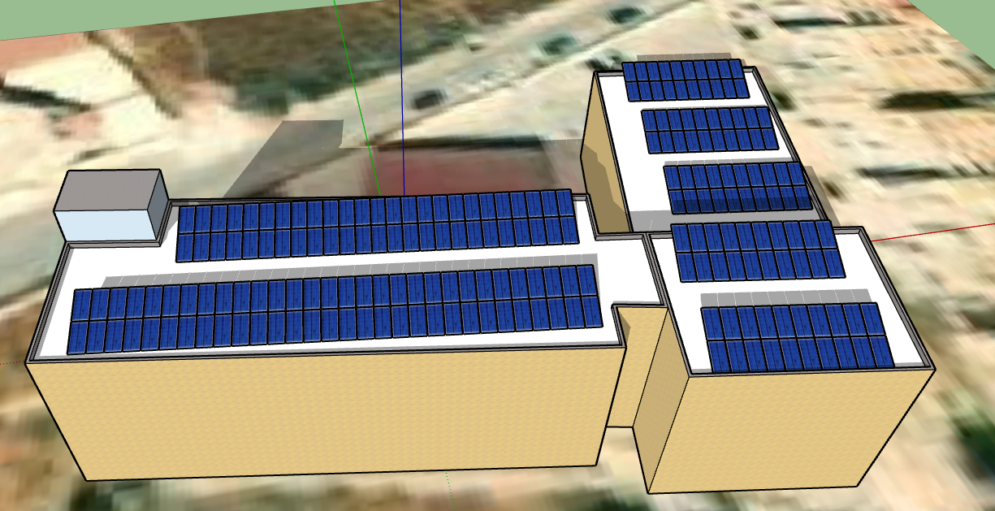
Concerted Action on Buildings
29 March 2022
Renewable Energy Systems
Photovoltaic System

Slide 17
Concerted Action on Buildings
29 March 2022
Figures and Numbers
84 tons
CO₂-equivalent emissions reduction per year

Slide 18
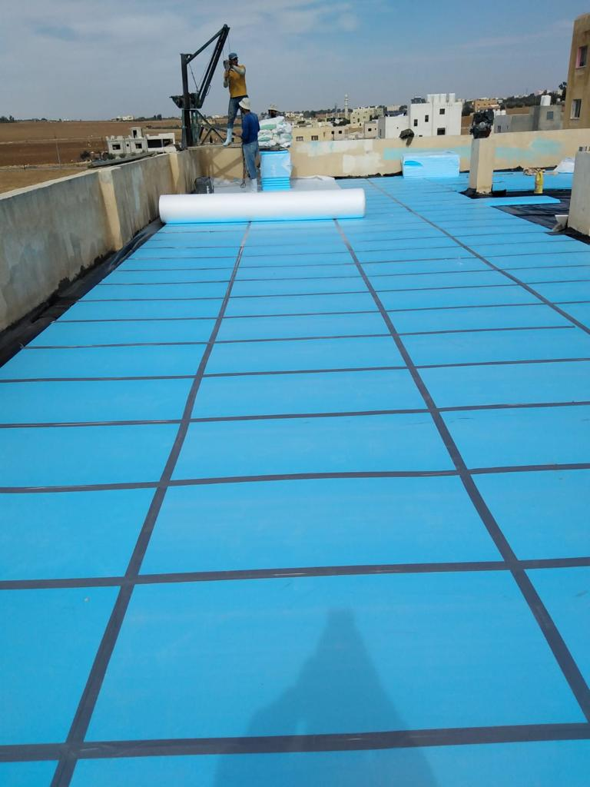
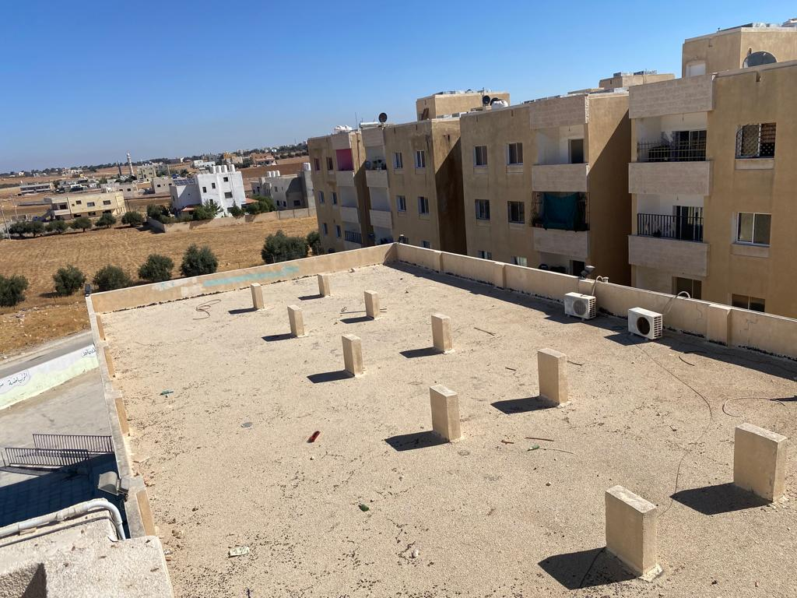
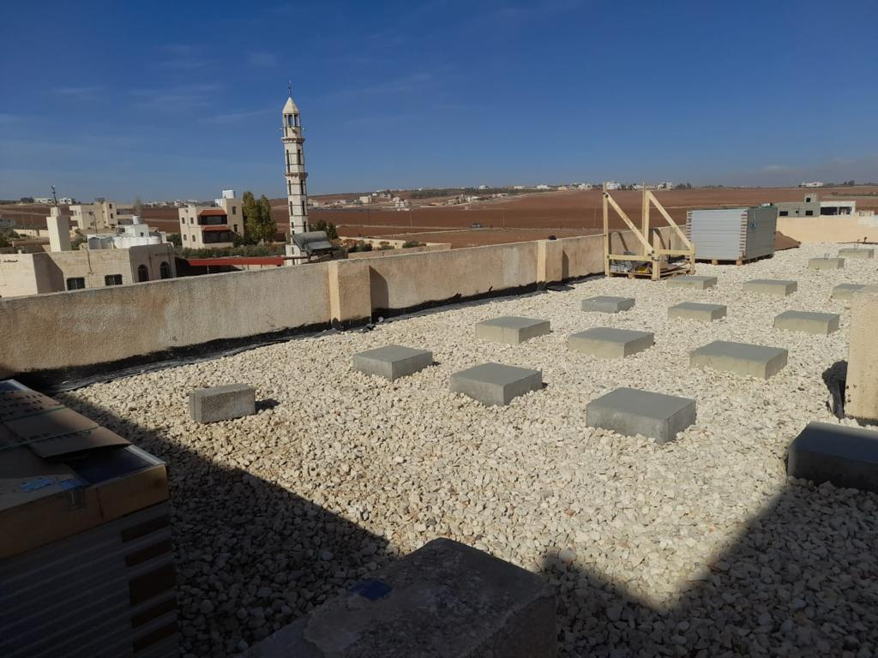
Implementation Images
Concerted Action on Buildings
29 March 2022

Slide 19
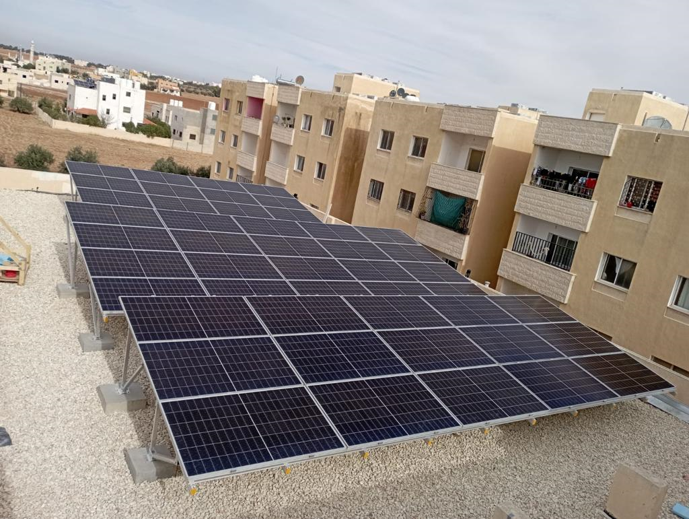
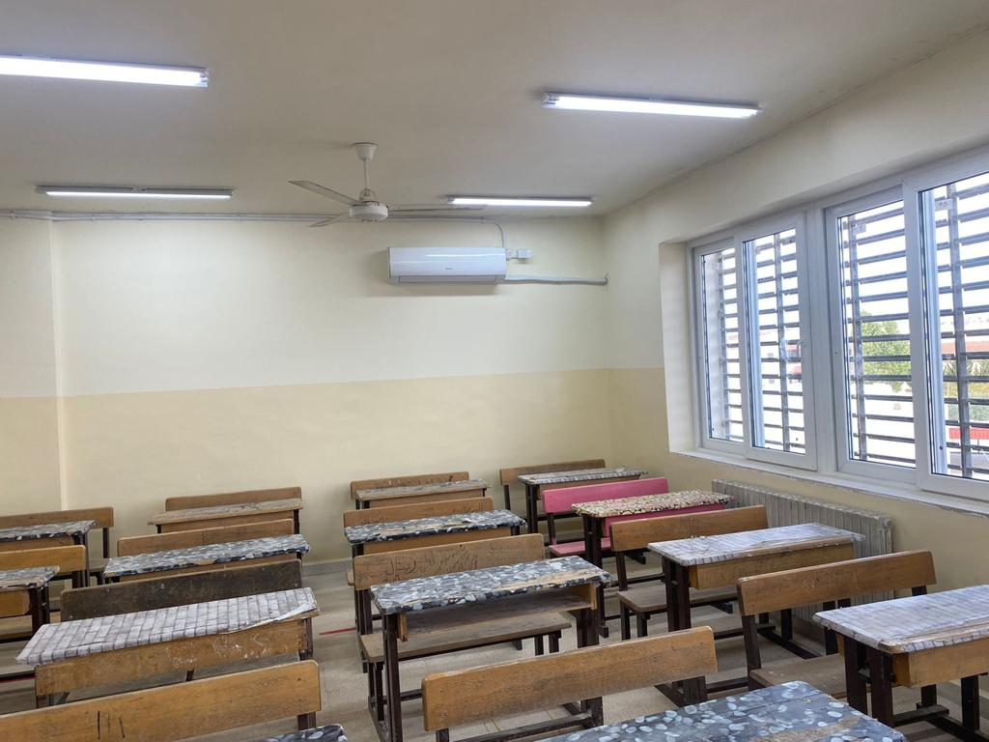
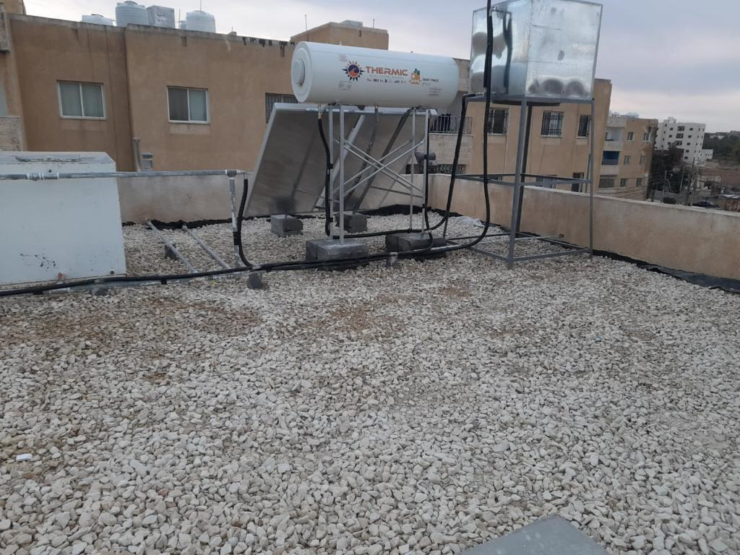
Implementation Images
Concerted Action on Buildings
29 March 2022

Slide 20
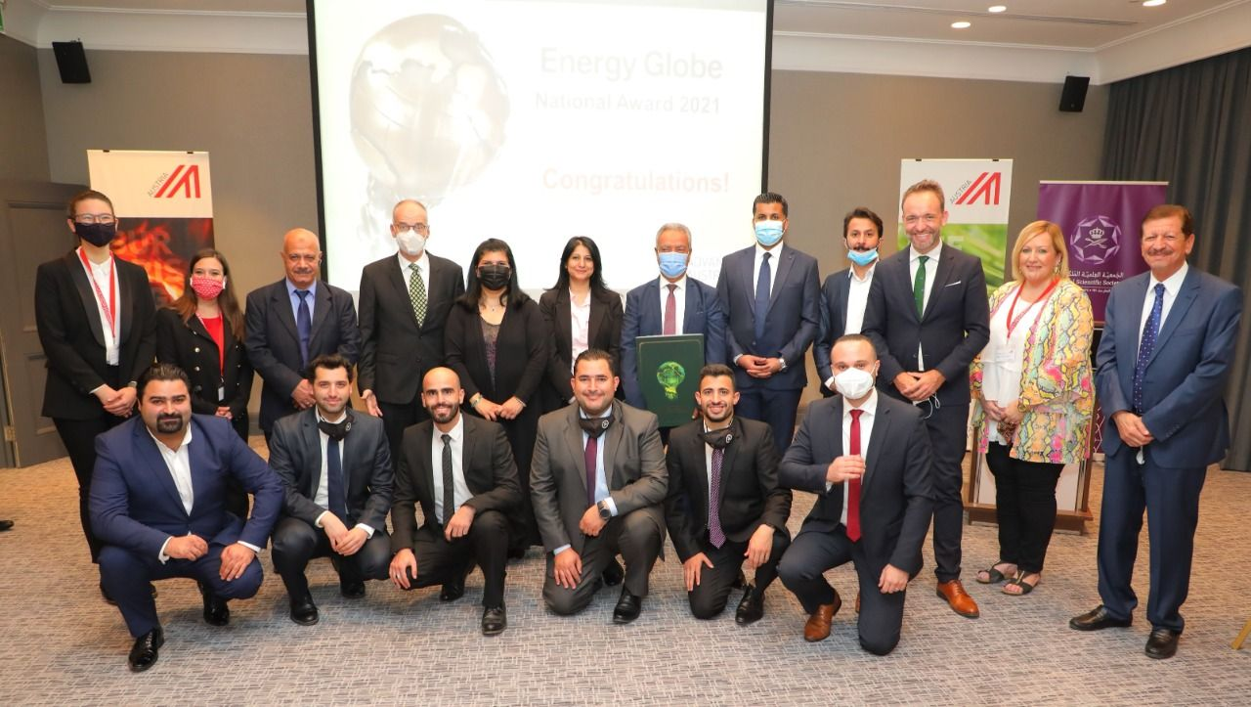
Concerted Action on Buildings
29 March 2022
The Energy Globe Award for 2021
“Public Schools Heating Project”

Slide 21
Concerted Action on Buildings
29 March 2022
Thanks
for your attention

