Slide 1




meetMED Week – Cairo 2022
Plenary Session 4: Concerted Actions on Buildings (Part 2)
Technicalities of EE in Buildings
Buildings Labelling
GRASSMED Green BOOCC
Tuesday 29 March 2022
Rayan Mourtada

Slide 2
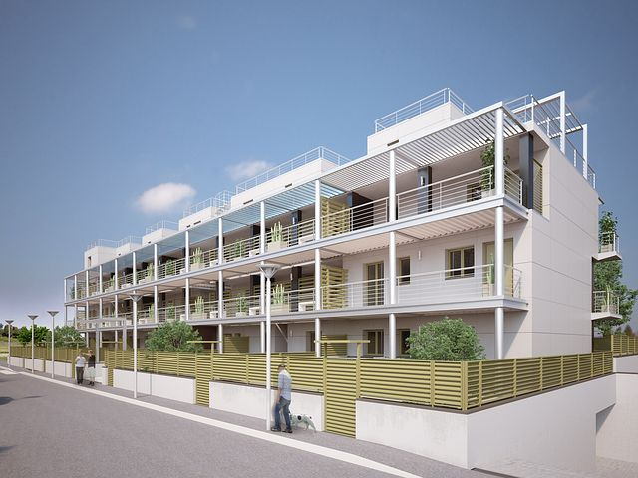
Concerted Action on Buildings
GRASSMed : A regional, free, voluntary Green Building Label Certification
GRASS – Green Recovery And Sustainable Solutions
Is a South Mediterranean approach to a South Mediterranean rating system for New Designed and Existing Commercial & Residential Buildings.
Aspires to mitigate the negative impacts of buildings on the environment including CO2 emissions, heat island effect, intensive energy consumptions, water consumption…etc.
Aims to provide our next generations with the opportunity to live in healthier, durable, and environmentally friendly buildings.
Overview:

Slide 3
Concerted Action on Buildings
GRASSMed : A regional Green Building Label
GRASSMed is free and voluntary.
Intended for Residential and Tertiary sectors.
Intended for existing Buildings as well as new Buildings.
GRASSMed has been fully developed and implemented for Lebanon (MeetMED I) and is based on the Thermal Standard for Buildings for Lebanon (TSBL2010, developed by ALMEE in collaboration with ADEME)
In development for South Mediterranean countries of MEDENER as part of WP3 of MeetMED II

Slide 4
Concerted Action on Buildings
GRASSMed : A regional, free, voluntary Green Building Label Certification
GRASS consists of four major categories of indicators
Envelope
Energy System Design and Equipment
Water Management and Indoor Environment
Green
Sites

Slide 5
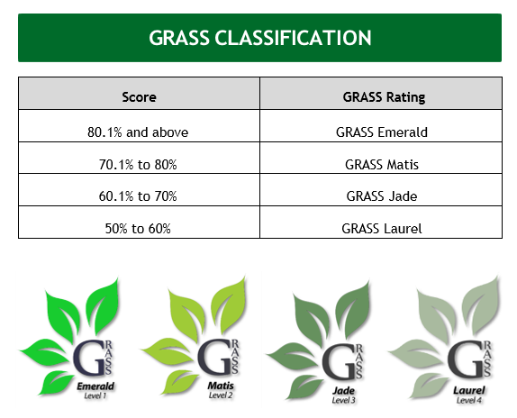
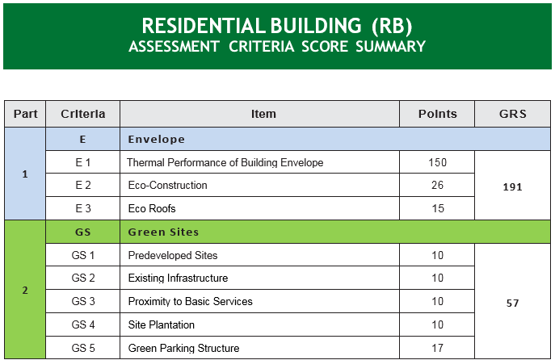
Concerted Action on Buildings
GRASSMed : A regional Green Building Label

Slide 6
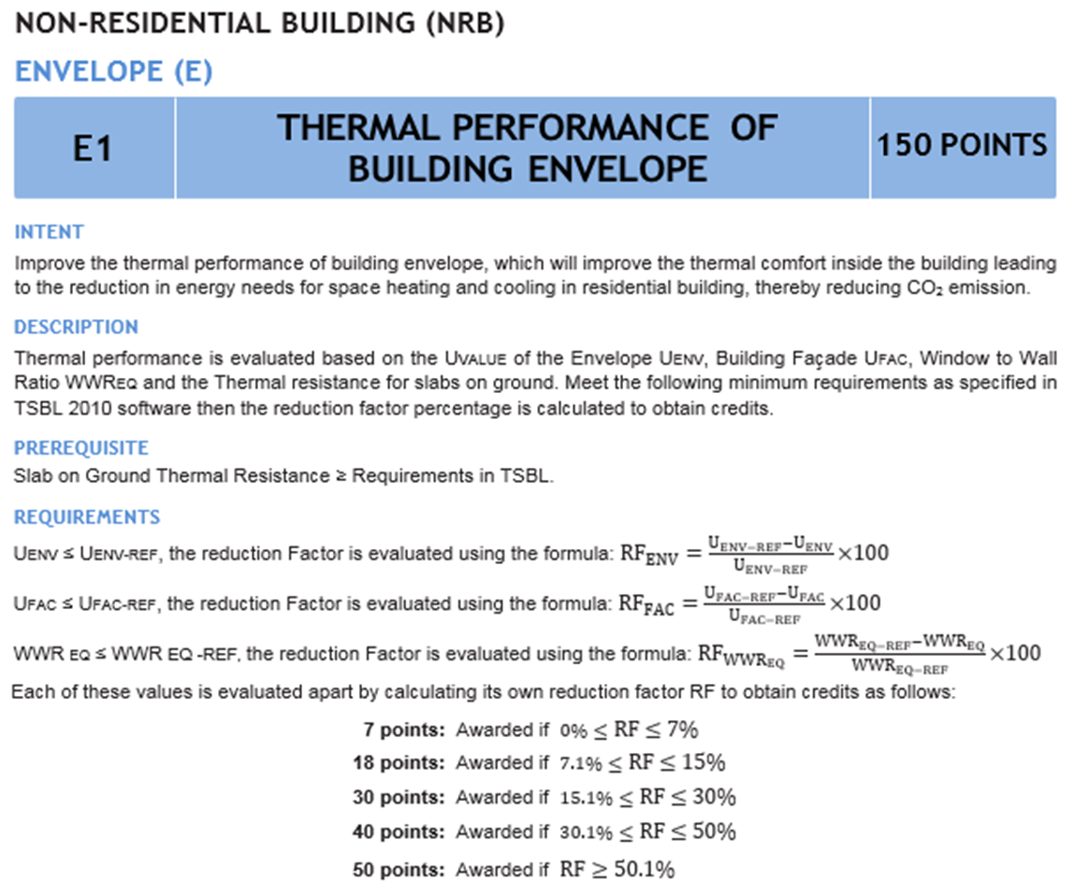
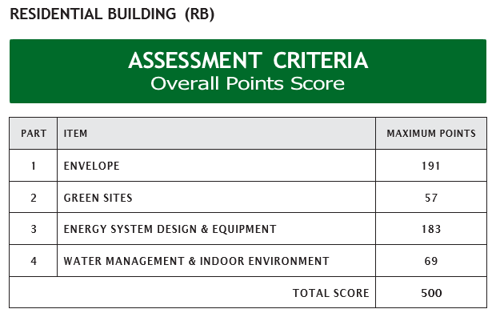
Concerted Action on Buildings
GRASSMed : A regional Green Building Label

Slide 7
Concerted Action on Buildings
But why GRASSMed ?
International Building Certification labels (LEED, BREEAM) have been developed for western countries, where EE and RE industries and markets are more advanced, thus making the standards often unreachable.
Certification processes and fees can be daunting to applicants.
GrassMed is to be tailored from the reality of local green building markets, and is intended to evolve with these markets
The platform offers a set of useful tools for construction professionals and students alike, allowing them to test their design while taking into consideration national building codes and/or labels for each participating country.
Overall, it’s a powerful mean to get familiar with energy efficiency and sustainability.

Slide 8
Concerted Action on Buildings
The lack of a regulatory framework and financial schemes supporting EE measures in SMCs, or their lack of implementation can hinder any labelling efforts.
ALMEE Actions in Lebanon :
Top down approach : Development of Regulatory and Fiscal Instruments for Green Buildings in collaboration with LGBC/CEDRO
        OUTPUT : A draft Law to be submitted to the Parliament
Bottom Up approach : The Municipality of Baakline Case

Slide 9
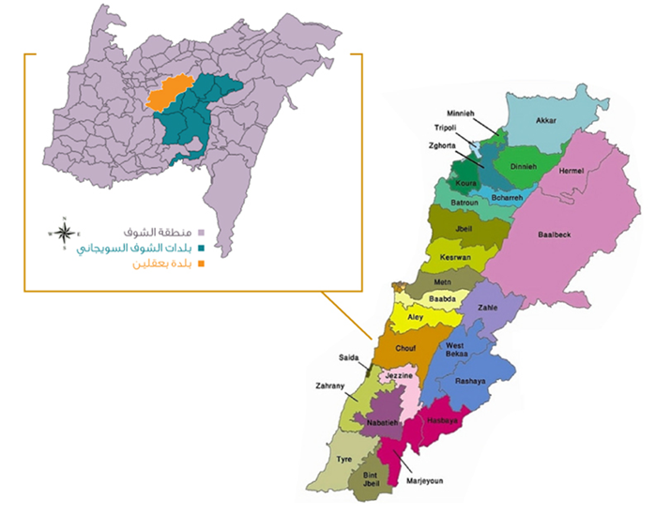
Concerted Action on Buildings
The Municipality of Baakline Case
Local authorities play an important strategic role in EE for buildings in Lebanon. As shared before in the JOINT EURO-MEDITERRANEAN WORKSHOP, a good practice in EE for buildings in the Municipality of BAAKLINE-Chouf’s achievements are considered as a concrete model of the way the local authorities can develop and manage their territory.
It is likely that it is the bottom-up approach that has the best chance of achieving this reconciliation of the territory, while mobilizing all its economic and social actors, as well as the entire population around the energy issue.

Slide 10
Concerted Action on Buildings
The Municipality of Baakline Case
Local authorities can be an important actor in:
- Regulations and incentives for EE in buildings at local level: thermal insulation, improving envelop quality, solar heaters, efficient lighting….
- Local policies and action plans
- Awareness and Capacity Building with the assistance of the civil society
Like many other authorities in Lebanon, they were able to be engaged in the Covenant of Mayors through the CES-MED program and elaborate their Sustainable Action Plan where many actions were considered for EE in buildings (public and private, new and existing) and which turned out to be a good opportunity for the city to improve its energy and sustainable development policy.

Slide 11

Concerted Action on Buildings
The Municipality of Baakline Case
They were able also to build the capacity of the actors for buildings within the territory (municipal agents, local engineers/assessors…) for Green Building labelling and particularly for GRASS in collaboration with the Lebanese University and ALMEE.
Thanks to a European fund (SUDEP), the authority of Baakline-Chouf developed its Municipal Energy Policy and disseminated it to the entire Federation of Chouf-Soueijany region, in partnership with the Lebanese University and ALMEE. This aimed to transform Baakline into a smart city and spread the objectives of the EU by adopting renewable energies and energy efficiency measures in general, and by developing and implementing sustainable policies and legislation, to motivate people to adopt the standards of "Green Building”.

Slide 12
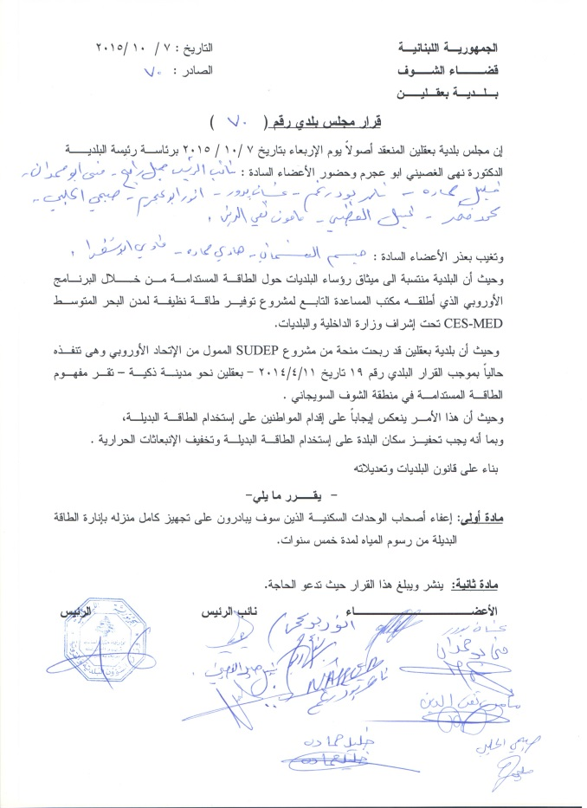
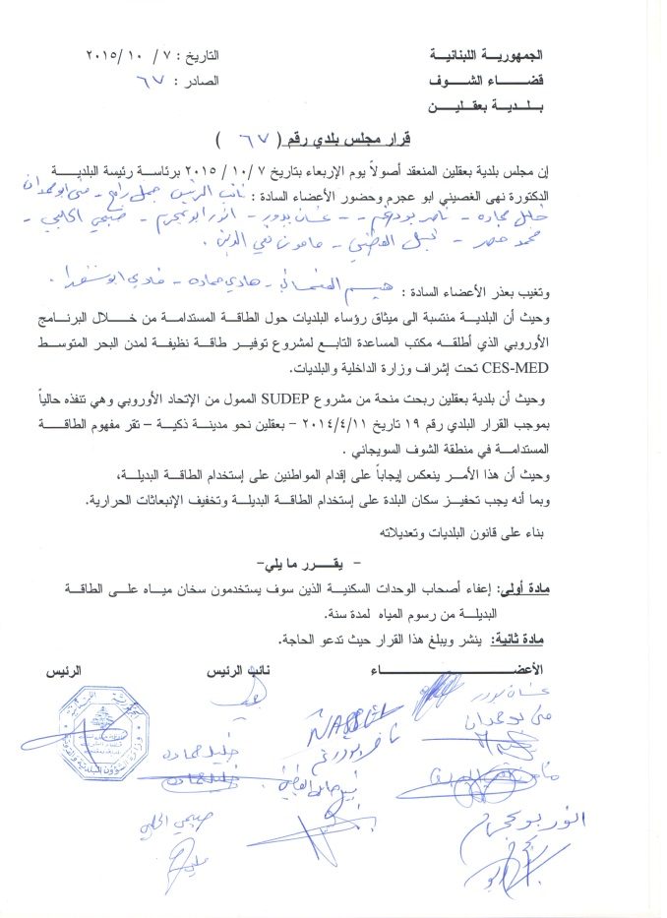
Les décrets municipaux pris par MBAA dans le but de motiver la population à profiter des énergies renouvelables
1er Décret
2nd Décret
Exempter ceux qui construisent leurs bâtiments suivant les normes de « green Building » de redevances sur l'eau pendant 5 ans
Exempter ceux qui utilisent le chauffe – eau solaire de redevances sur l'eau pendant un an

Slide 13
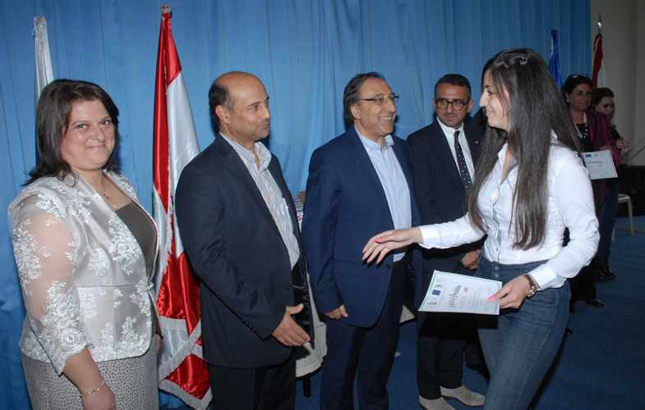
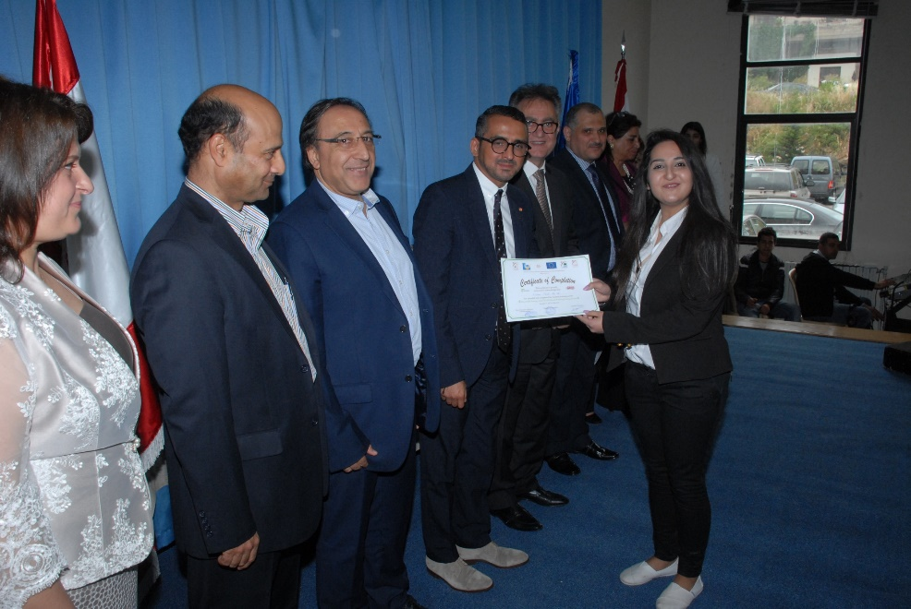
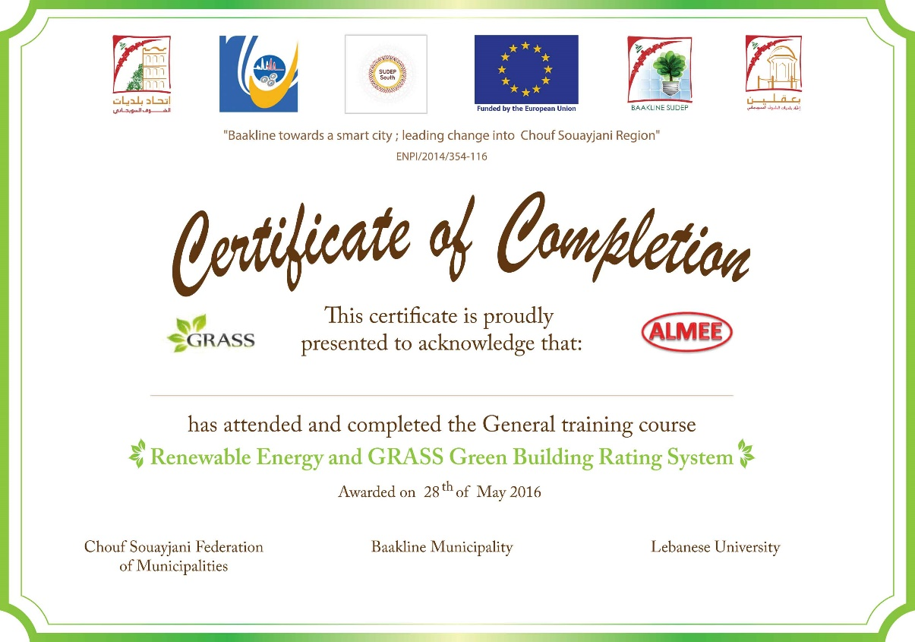
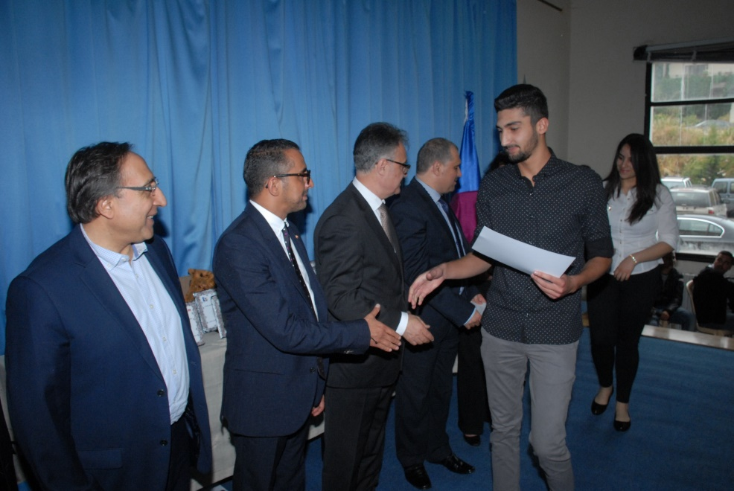
Sessions d'entrainement pour les étudiants du CNAM- LU à Baakline

Slide 14
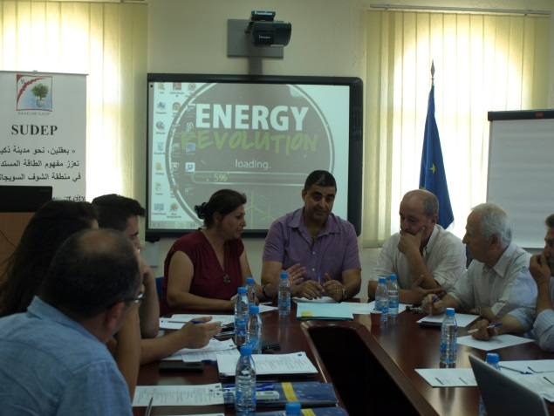
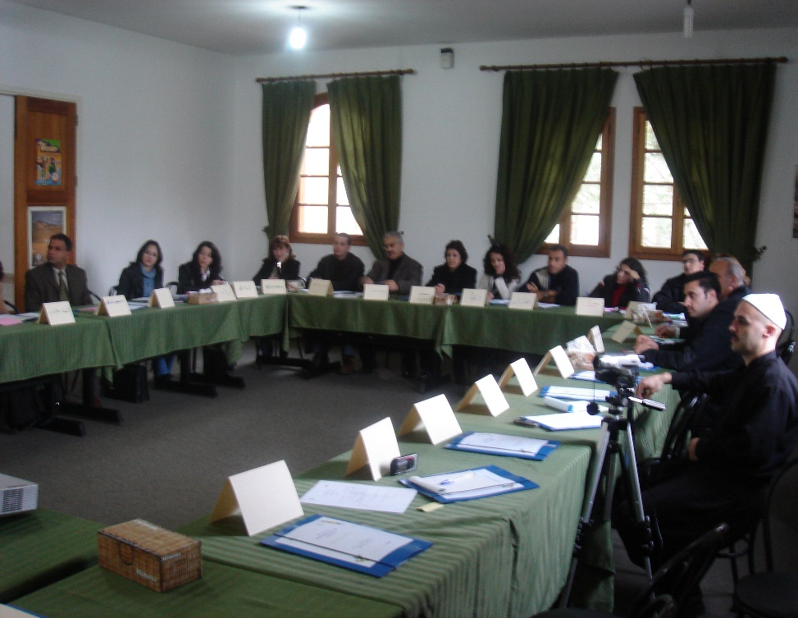
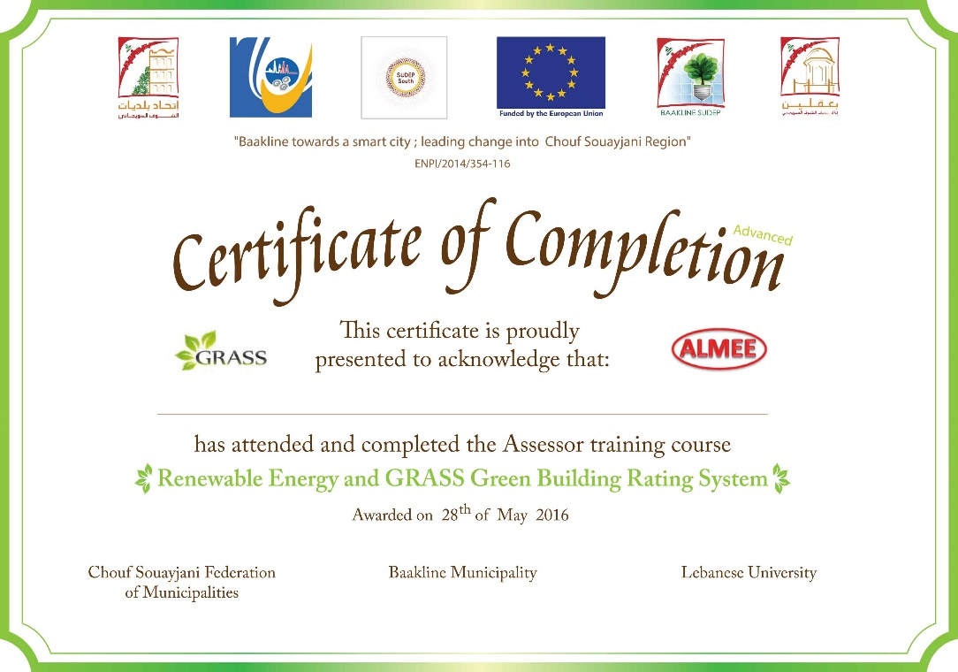
Sessions de Formation des Assesseurs GRASSMed, adressées aux ingénieurs, agents municipaux, employés de la Direction Générale de l'Urbanisme et intimes par le sujet.
"Route verte vers le développement durable".
La situation de l'énergie au Liban - crises et solutions
l’impact des bâtiments sur l’énergie: matériaux, eau, émissions CO2.
Comment réduire ces impacts
Système de notation pour la construction verte
Intégration des mesures Efficacité énergétique dans les bâtiments (GRASS Med).

Slide 15












GRASSMED Green BOOCC Platform
Green
Building
Platform
A large number of participants connected at the same time on the platform
Open
Accessible free to all users
MEDENER Agencies can share Guides, information, regulations …
Online
Online to be connected at any time to the agencies, community of professionals educators and assessors
Courses
A real educational path allowing the acquisition of knowledge , share best practices and becoming assessors
Certification
Online registration of the project and obtaining a provisional Green building
certificate
GRASSMED

Slide 16
Concerted Action on Buildings
  The GRASSMED Green BOOCC Platform (Green Building Open Online Courses and Certification) offers training and E-learning (Open Online Courses), that is to say free, open to all and a free "Green Building" certification.
  Provisional certification and labeling (Provisional Certificate) could be obtained freely on the GRASSMED website by the user.
  Certification and final labeling (Final Certificate) could be obtained on the GRASSMED website but filed by an assessor registered on the list of approved GRASSMED certifiers.
  The GRASSMED assessor should take courses, an "Online" part and a part in "Training seminars" and pass an evaluation.

Slide 17
Concerted Action on Buildings
GRASSMED Green BOOCC Platform is dedicated to :
  certification and labeling of sustainable buildings in the South Mediterranean countries,
  the dissemination to a general public’ knowledge of the challenges linked to sustainable building,
  strengthen the skills of professionals in the building and real estate sector on the themes of energy transition and sustainable building in general,
  train engineering students and architecture students in the design and construction of sustainable buildings (with focus on public buildings),
  the creation of a space for exchange for institutional and professional players and for sharing knowledge and skills on sustainable buildings.

Slide 18
Concerted Action on Buildings
Objectives of the GRASSMed GreenBOOCC Platform
Contribution to the implementation of the energy transition policies of the Southern Mediterranean countries in building sector (SMC).
Promote the construction of sustainable buildings in the South Mediterranean Countries and encourage the penetration and development of green materials, equipment and technologies.
Promote energy efficiency in buildings (new and existing, social or standing) using a regional label as a vehicle for awareness, communication and exchange of expertise.
Anticipate the evolution of current Energy Buildings Codes in SMC by encouraging operators and users to go beyond the requirements of current thermal regulations of buildings.

Slide 19
Concerted Action on Buildings
Impact of GRASSMED Green BOOCC Platform for actors
Dissemination of EE & RE advanced solutions, assistances in construction of green buildings, diffusion of energy and environmental typical concepts adapted by climate zone and categories of buildings (schools, office, residential, public, etc…).
An optimal organization of construction project: development of skills, technical guidelines and standards, technical assistance to evaluate alternatives and make the best choice of EE materials, solutions and equipment..
Regional green building certification system in addition to the national green labels (if they exist), verification and validation of energy building performance and environmental qualities.

Slide 20
Concerted Action on Buildings
Impact of GRASSMED Green BOOCC Platform for actors
Training and Education
  Assessors
  Architects, Design Offices and Companies
  Students of engineering schools and architects
Information on existing grants, subsidies and sources of financing in each country.
Assistance to the South MEDENER agencies and banking sectors on evaluating of EE indicators of construction projects adapted to the needs of owners and donors (credit lines).

Slide 21
Concerted Action on Buildings
GRASSMED GREENBOOCC Course of actions
Creation of GRASSmed Green BOOCC Platform
Implementation of GRASSmed Green BOOCC Platform

Slide 22
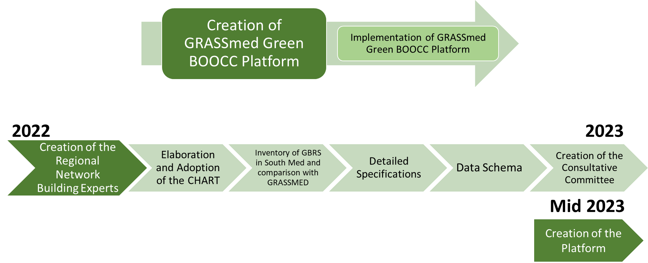
Concerted Action on Buildings
GRASSMED GREENBOOCC Timetable

Slide 23
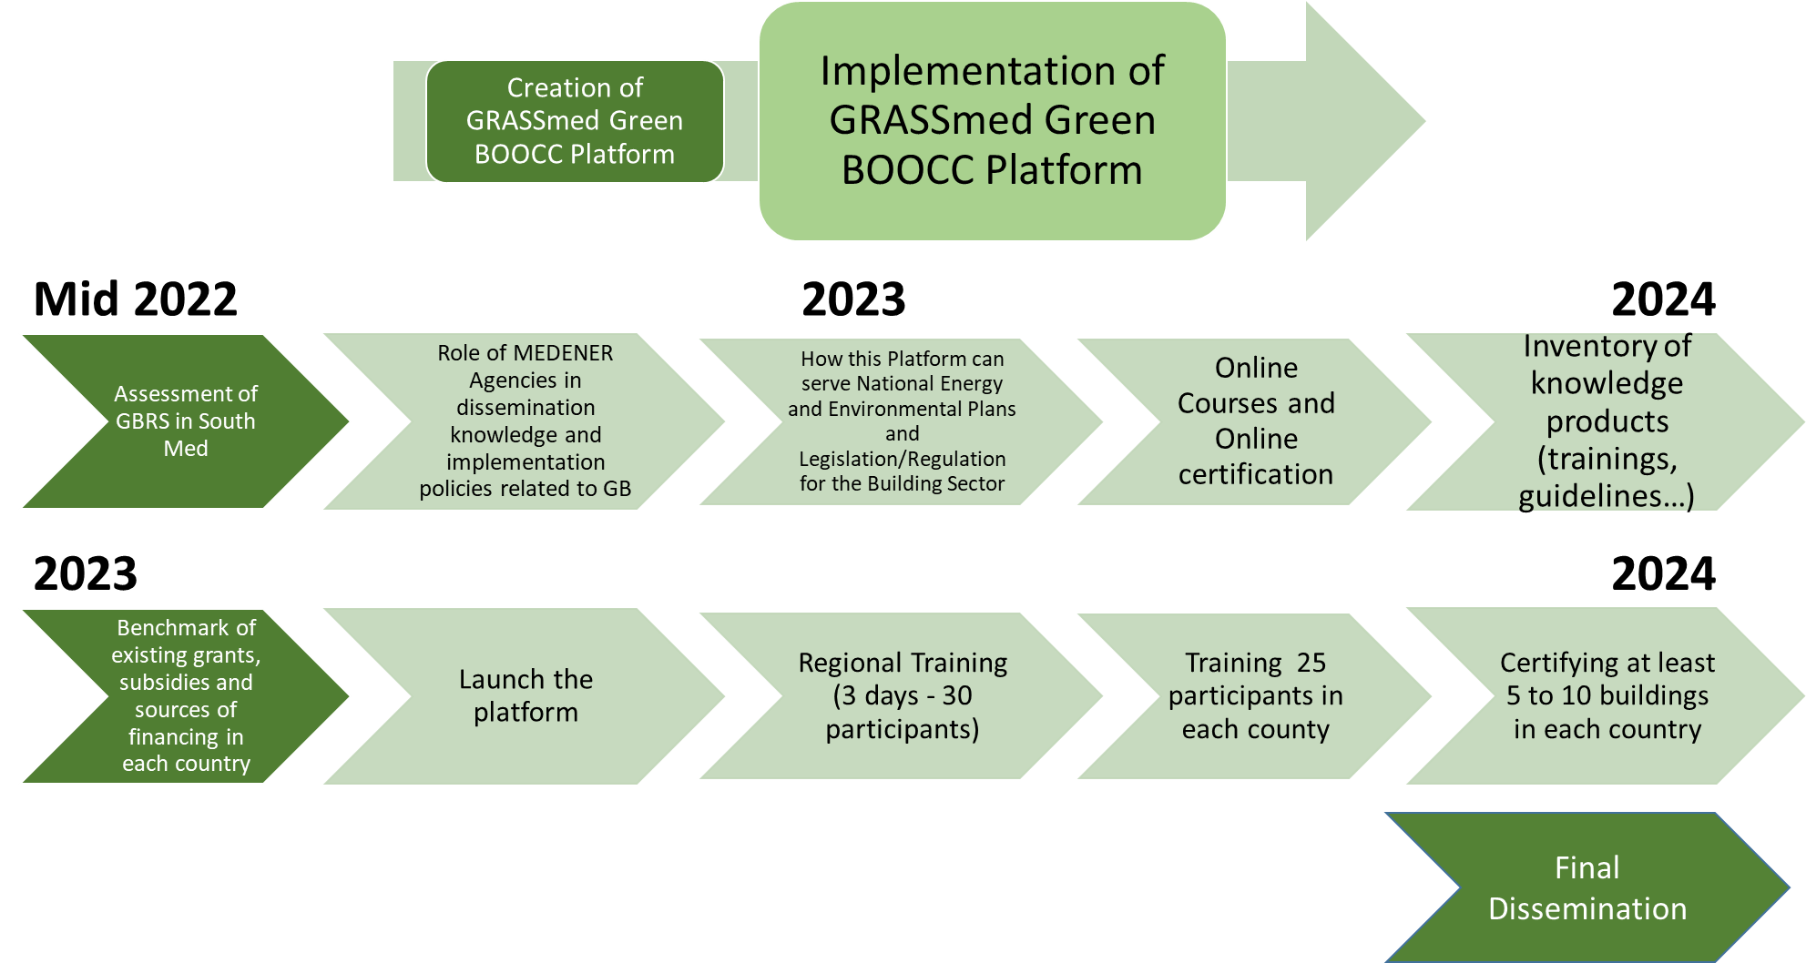
Concerted Action on Buildings
GRASSMED GREENBOOCC Timetable

Slide 24


