Slide 1
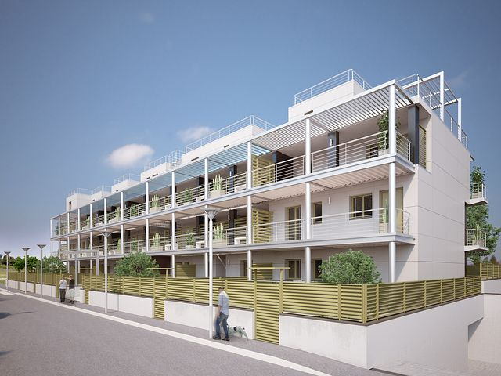
Concerted Action on Buildings
meetMED WEEK
28-31- March 2022
Concerted Action on Buildings
Summary from day 2
29th March

Slide 2

Summary
Concerted Action on Buildings
Very intensive day with 27 presentations between invited speakers and the coordination team
Keynote presentations provided a good EU context and overview ➔ Green deal and Renovation Wave; the experience from the CA-EPBD; the work of European energy agencies (EnR) supporting the renovation wave at national and local level
Roundtable - Strategies and policies on building sector. Experiences from local to regional, highlighting the roles of each stakeholders in taking action ➔ Diversity of solutions and their condition of success that contribute at each scale to change progressively but massively the practices in the sector.
    How to mobilise institutions, ministries and private sector at national level ?
    How to mobilize local authorities and how do they play a crucial role, not only as exemplary builders but also as decision makers ?
    Best Practices – 8 concrete examples from countries in areas related to building codes, building renovation, labelling and financing
    Discussion and next steps in the activity 2.2 – Concerted Action

Slide 3
Takeways
Concerted Action on Buildings
Solid demonstration on the links between energy efficiency measures in buildings and climate related impacts both on mitigation and adaptation.
Existing policy instruments might not be enough. Need for mandatory building codes embedding progressively adaptation issues, combine approaches between energy and water management in buildings, as potentially other dimensions.
Best cases, pilot projects or labelling schemes that promote best solutions and create a positive differentiation should be incentivized for inspiration.
Dialog and necessary interaction between national and local level is key. Very important role of local authorities in enforcing national policies and providing support to different stakeholders.
Interaction between public and private financing stakeholders to create financing mechanisms to mobilize the necessary investment needed in the construction sector to adapt to sustainable construction.
Raise awareness on energy transition and qualify the construction sector to create the market need to boost the buildings renovation wave.

Slide 4
Cop 27 messages…
Concerted Action on Buildings
A well stabilized legal framework with building codes, minimum energy performance requirements and standards is essential to support the development of new buildings or renovations.
The development of a set of tools related with labelling of buildings or its systems/components is essential to promote a positive differentiation and drive better solutions and efficient technologies.
Capacitation of Professionals, Citizens and Public Authorities on buildings renovation enables the countries to achieve national targets in line with global ones, thanks to behavioral changes and governance capacities, among others.
Development of fair and well-balanced financing systems can assure robust support to both sustainable new building and existing ones, as well as they can provide sustainable economic impact and other benefits.

Slide 5
Concerted Action on Buildings
Thank you.
rui.fragoso@adene.pt

